Slide 1
Deep Learning for Beginners
From Basics to Production with NumPy and TensorFlow

Slide 2
Where Are Neural Networks Used?
Neural Networks have application in a handful of spaces:
Image/Audio/Video recognition – Each pixel becomes a numeric value inputted into a neural network, and it outputs a classification (e.g. surveillance systems, face tagging, radiology diagnoses, etc).
Image/Audio/Video generation – Patterns are found in images, video, or audio and can be used to produce new images, video, and audio (e.g. DeepFakes, image repair, artwork, etc)
Chatbots and text generation – Chaining probabilities of words/letters occurring in training texts to generate new text, such as ChatGPT.
Advertising – Targeting users with advertisements based on their activity and history.

Slide 3
Common Types of Neural Networks
Multilayer Perceptron (MLP) – What we’ve been working with in this class, which is a neural network with one or more hidden layers (a.k.a deep learning).
Convolutional Neural Network (CNN) – A neural network with a convolutional layer that makes inputs more fuzzy (think blurring an image) so it uses less parameters and generalizes perception problems like computer vision.
Recurrent Neural Networks (RNN) – A circuitous neural network that takes the output but then makes it an input again to perform tasks like generating text.
Long Short-Term Memory Networks (LSTM) – An improvement of RNN’s that selectively holds outputs in memory, and often used for generating text and language.
Transformer Neural Networks – A powerful improvement over LSTM that utilizes “attention” to capture context on longer sequences and is a key part of the ChatGPT development.

Slide 4
ChatGPT Example
PROMPT: Write a story about taking a cat smudge to the vet, but as a humblebrag LinkedIn post
It was a typical Wednesday morning and I was getting ready for work when I noticed that my beloved cat, Smudge, wasn't acting quite like himself. He was lethargic and didn't seem interested in his breakfast, which was highly unusual for a cat who usually greets each day with unbridled enthusiasm.
I quickly realized that something was wrong and decided to take Smudge to the vet. I called my boss to let them know I would be late and headed out the door with my furry friend in tow.
At the vet's office, the doctor carefully examined Smudge and ran a few tests. It turned out that he had a urinary tract infection, which was causing him discomfort and lack of appetite.
I was relieved to know that the issue wasn't serious and that Smudge would be back to his usual self in no time with the right treatment. The vet prescribed some medication and I carefully administered it to Smudge at home, making sure he was comfortable and had plenty of water to drink.
As a responsible pet owner, it's important to me to prioritize my furry friend's health and well-being. I'm grateful to the dedicated professionals at the vet's office who were able to diagnose and treat Smudge quickly and effectively.
I'm also grateful for the support of my employer, who allowed me the flexibility to take the time necessary to ensure Smudge received the care he needed. It just goes to show that even on a busy Wednesday morning, it's possible to prioritize the things that matter most in life. #petlove #veterinarian #catsofLinkedin

Slide 5
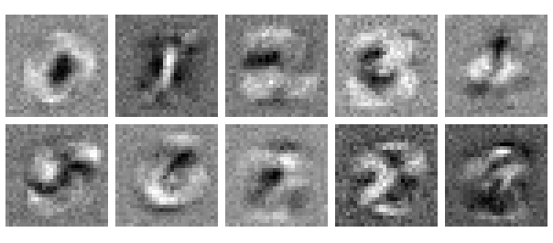
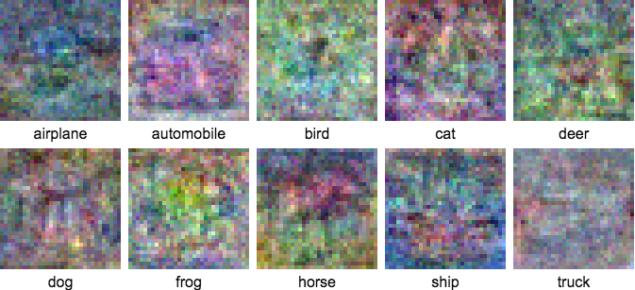
Applied Example: Computer Vision
A good way to think about how neural networks are used for computer vision is that each pixel’s darkness will contribute probabilistically to a shape, and that shape contributes probabilistically for a classification.
Each pixel is a numeric variable, and we use optimization to find parameters weighing those variables to match a label, while hoping the parameters do not overfit, bias, etc.
To the right are heat maps of weights to identify handwritten numbers 0-9, as well as various animals/vehicles trained on a large set of images.
SOURCE: https://ml4a.github.io/ml4a/looking_inside_neural_nets/

Slide 6
A Scikit-Learn Neural Network to Recognize Handwritten Digits
import numpy as np import pandas as pd # load data from sklearn.model_selection import train_test_split from sklearn.neural_network import MLPClassifier df = pd.read_csv('../../data/mnist_784.csv', delimiter=",") # Extract input variables (all rows, all columns but last column) # Note we should do some linear scaling here X = (df.values[:, :-1] / 255.0) + .01 # Extract output column (all rows, last column) Y = df.values[:, -1] # Get a count of each group to ensure samples are equitably balanced print(df.groupby(["class"]).agg({"class" : [np.size]})) # Separate training and testing data # Note that I use the 'stratify' parameter to ensure # each class is proportionally represented in both sets X_train, X_test, Y_train, Y_test = train_test_split(X, Y, test_size=.33, random_state=10, stratify=Y) nn = MLPClassifier(solver='sgd', hidden_layer_sizes=(100, ), max_iter=480, learning_rate_init=.1) nn.fit(X_train, Y_train) print("Training set score: %f" % nn.score(X_train, Y_train)) print("Test set score: %f" % nn.score(X_test, Y_test))

Slide 7
Scenario: Computer Vision Basics
model = Sequential()
model.add(Dense(n_pixels, input_shape=(n_pixels,), activation='relu'))
num_classes = y_test.shape[1]
model.add(Dense(num_classes, activation='softmax'))
# Compile model
model.compile(loss=MeanSquaredError(), optimizer='adam', metrics=['accuracy'])
# Fit the model
model.fit(X_train, y_train, epochs=10, batch_size=100, validation_data=(X_test, y_test))
# Evaluate the model
scores = model.evaluate(X_test, y_test, verbose=0)
print(f"Score: {scores[1]}")
from tensorflow.keras.losses import MeanSquaredError
from tensorflow.keras.datasets import mnist
from tensorflow.keras.models import Sequential
from tensorflow.keras.layers import Dense
from tensorflow.keras.utils import to_categorical
import numpy as np
np.set_printoptions(threshold=np.inf)
np.set_printoptions(linewidth=np.inf)
# load data
(X_train, y_train), (X_test, y_test) = mnist.load_data()
# shape data
X_train = X_train / 255
X_test = X_test / 255
n_pixels = X_train.shape[1] * X_train.shape[2]
X_train = X_train.reshape((X_train.shape[0], n_pixels)).astype('float32')
X_test = X_test.reshape((X_test.shape[0], n_pixels)).astype('float32')
y_train = to_categorical(y_train)
y_test = to_categorical(y_test)
https://katacoda.com/orm-thomas-nield/courses/oreilly-deep-learning-beginners/05-computer-vision-basics

Slide 8
Preparing and Scaling Data

Slide 9

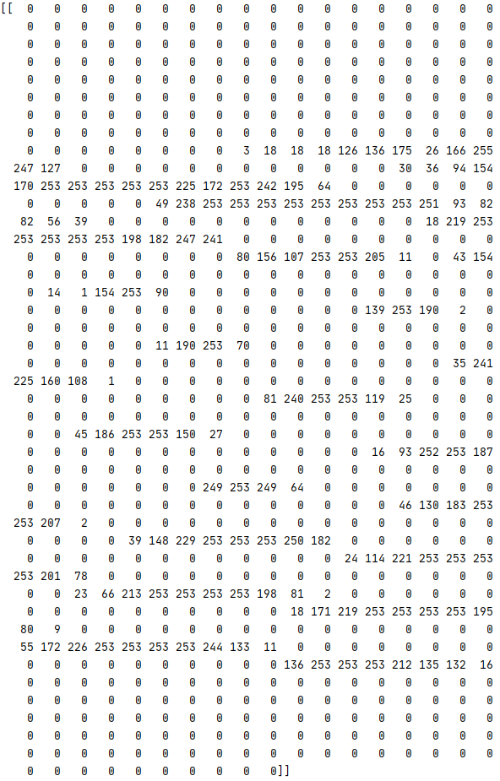
Preparing Data for Machine Learning
Before you start modeling a critical step is preparing the data, so features are represented in a math-friendly way.
Data needs to be pulled, joined with other data, and aggregated with the right features extracted.
All data (including text and images) must be turned into grids of numbers called matrices.
Different fields of data (e.g., employee age [0-99] and salary [0-1,000,000]) might need to be scaled into similar number ranges using transformation techniques.
The numeric machine learning data we just created above needs to be traceable back to the original data.
Turning a hand-written “5” into a matrix of numbers, each representing a pixel.

Slide 10
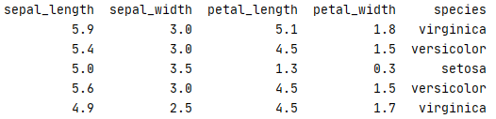
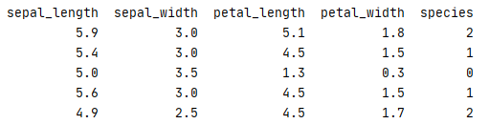
Converting to Numbers
Machine learning algorithms only work with numbers, so any non-numeric data types like dates and strings must be converted to floating point decimals or integers.
Binary variables: true/false = 1/0
Category variables: dog/cat/bird = 0/1/2
String variables: apply categories, assign integer tokens, Word2vec
To the right, we see the “species” column for an iris dataset turned into numerical categories.
import pandas as pd from sklearn.preprocessing import LabelEncoder df = pd.read_csv('https://bit.ly/39RbG1D', delimiter=",") # LabelEncoder will turn categorical labels into integers LE = LabelEncoder() df['species'] = LE.fit_transform(df['species']) print(df)

Slide 11
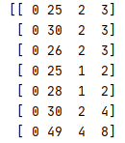
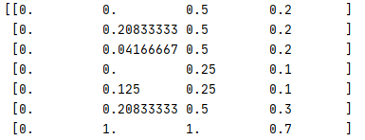
Rescaling
When you have different fields with varying scales, it can be helpful to rescale, or normalize, the data by compressing it between 0.0 and 1.0.
This can be helpful for optimization algorithms that perform machine learning training, making it easier to iterate parameters to fit the data more productively.
Note you do not always have to rescale, but sometimes it can give a better result especially for data with fields that vary in scale.
import pandas as pd from sklearn.preprocessing import MinMaxScaler df = pd.read_csv('https://bit.ly/33iTfS9', delimiter=",") # Extract input variables (all rows, all columns but last column) X = df.values[:, :-1] # Extract output column (all rows, 5th column) Y = df.values[:, 4] # Rescale all the input variables to be between 0 and 1 scaler = MinMaxScaler(feature_range=(0.0, 1.0)) rescaled_X = scaler.fit_transform(X) print(rescaled_X)
Doing a simple rescale between 0.0 and 1.0 above in scikit-learn

Slide 12
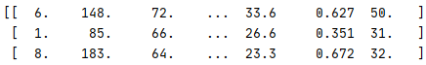
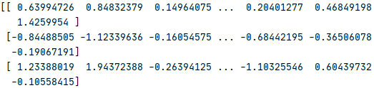
Standardization
Standardization is transforming numeric variables to fit a standard normal distribution (with a mean of 0 and standard deviation of 1) and express each value in standard deviations.
It can be preferable to rescaling if the data can assume a normal distribution for each variable.
In other words, standardization is finding the z-scores for each variable.
import pandas as pd from sklearn.preprocessing import StandardScaler df = pd.read_csv('https://bit.ly/3flZJSR', delimiter=",") # Extract input variables (all rows, all columns but last column) X = df.values[:, :-1] # Extract output column (all rows, last column) Y = df.values[:, -1] # Rescale all the input variables to be between 0 and 1 scaler = StandardScaler().fit(X) rescaled_X = scaler.fit_transform(X) print(rescaled_X)
Doing a standardization on all data fields

Slide 13
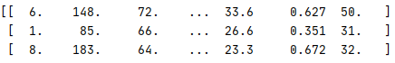
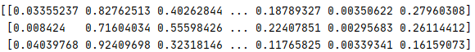
Unit Vector Normalization
Not to be confused with standardization, unit vector normalization is rescaling each data record to have a vector length of 1.0.
This is probably the most complicated transformation, as it involves some understanding of linear algebra.
It works well for sparse data sets and it compresses the data into a smaller space, which is especially helpful for high-dimension datasets.
It is often used for neural networks, k-nearest neighbors, and a few other ML algorithms.
import pandas as pd from sklearn.preprocessing import Normalizer df = pd.read_csv('https://bit.ly/3flZJSR', delimiter=",") # Extract input variables (all rows, all columns but last column) X = df.values[:, :-1] # Extract output column (all rows, last column) Y = df.values[:, -1] # Rescale all the input variables to be normalized scaler = Normalizer().fit(X) rescaled_X = scaler.fit_transform(X) print(rescaled_X)
Doing a normalization on all data fields

Slide 14
Selecting Features Automatically
While we recommend being analytical, methodical, and manual in choosing features to train on, there are several automated tools available to choose features for you.
Use carefully! Always analyze your data and know which features ML is using.
Scikit-Learn Method | Description
SelectKBest | Chooses the best K number of features, where K is provided by user (e.g. K=3 will choose top 3 features). “Best” is defined by Chi-Square or other methods.
SelectPercentile | Chooses highest scoring features within a percentile and utilizes Chi-Square or other benchmarking methods.
RFE | Uses recursive feature elimination (RFE) to select top K variables that impact a given machine learning model.
PCA | Principal component analysis (PCA) consolidates variables that have similar correlations into a single variable.

Slide 15
Selecting Features Automatically
SelectKBest
RFE
PCA
import pandas as pd from sklearn.feature_selection import SelectKBest, chi2 df = pd.read_csv('https://bit.ly/39RbG1D', delimiter=",") # Extract input variables (all rows, all columns but last column) X = df.values[:, :-1] # Extract output column (all rows, last column) Y = df.values[:, -1] # Extract the top 2 features that impact the outcome the most fit = SelectKBest(score_func=chi2, k=2).fit(X,Y) print(fit.scores_) features = fit.transform(X) print(features)
import pandas as pd from sklearn.feature_selection import RFE from sklearn.linear_model import LogisticRegression df = pd.read_csv('https://bit.ly/33iTfS9', delimiter=",") # Extract input variables (all rows, all columns but last column) X = df.values[:, :-1] # Extract output column (all rows, last column) Y = df.values[:, -1] # Extract the top 2 features that impact the outcome the most model = LogisticRegression(solver='liblinear') rfe = RFE(model, 2) fit = rfe.fit(X, Y) print("Selected Features: %s" % fit.support_) print("Feature Ranking: %s" % fit.ranking_)
import pandas as pd from sklearn.decomposition import PCA df = pd.read_csv('https://bit.ly/3i4cUcE', delimiter=",") # Extract input variables (all rows, all columns but last column) X = df.values[:, :-1] # Extract output column (all rows, last column) Y = df.values[:, -1] # feature extraction pca = PCA(n_components=3) fit = pca.fit(X) # summarize components print("Explained Variance: %s" % fit.explained_variance_ratio_) print(fit.components_)

Slide 16
Testing and Validation

Slide 17
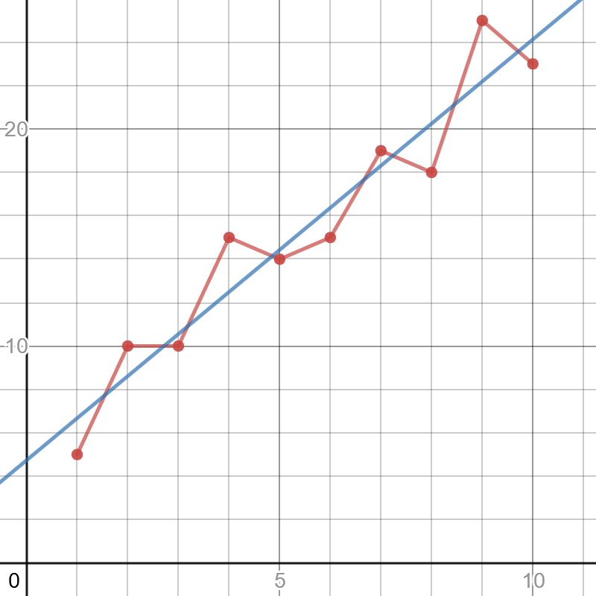
A Note About Overfitting
With neural networks, deep learning, and machine learning altogether you should concern yourself about overfitting.
Overfitting means that our ML model works well with the data it was trained on but fails to predict correctly with new data.
This can be due to many factors, but a common cause is the sampled data does not represent the larger population.
The red ”connect-the-dots” model has high variance, meaning its predictions are sensitive to outliers and therefore can vary greatly.
The blue line has high bias, meaning the model is less sensitive to outliers because it prioritizes a method (maintaining a straight line) rather than bend and respond to variance.
The red “connect-the-dots” model to the right is likely overfitted (high variance, low bias), but the blue linear regression (low variance, high bias) is less likely to be overfit.
https://www.desmos.com/calculator/wmwfolbvdk

Slide 18

A Note About Overfitting
Linear and logistic regression are highly biased methods and are resilient to overfitting, but neural networks/deep learning can have tendencies to overfit.
There are other remedies to mitigate overfitting, the most basic being separating training data and test data.
The model is fit to the training data, and then is tested with the test data.
If the test data performs poorly compared to the training data, there is a possibility of overfit (or just no correlation altogether).
You can also try to train with more data as well as utilize convolution, cross-validation, regularization, bagging, boosting, and other techniques.

Slide 19
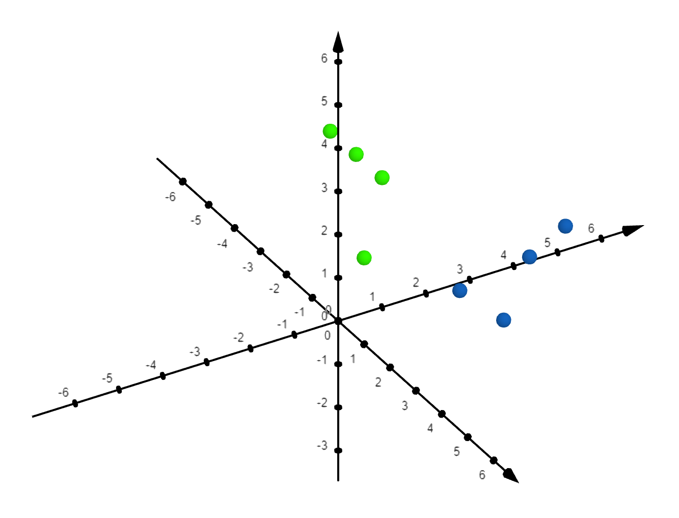
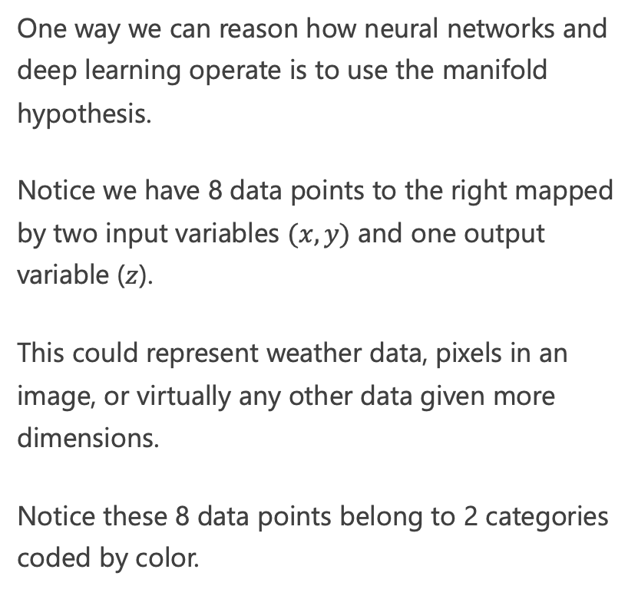
Manifold Hypothesis
One way we can reason how neural networks and deep learning operate is to use the manifold hypothesis.
Notice we have 8 data points to the right mapped by two input variables $(x,y)$ and one output variable ($z$).
This could represent weather data, pixels in an image, or virtually any other data given more dimensions.
Notice these 8 data points belong to 2 categories coded by color.

Slide 20
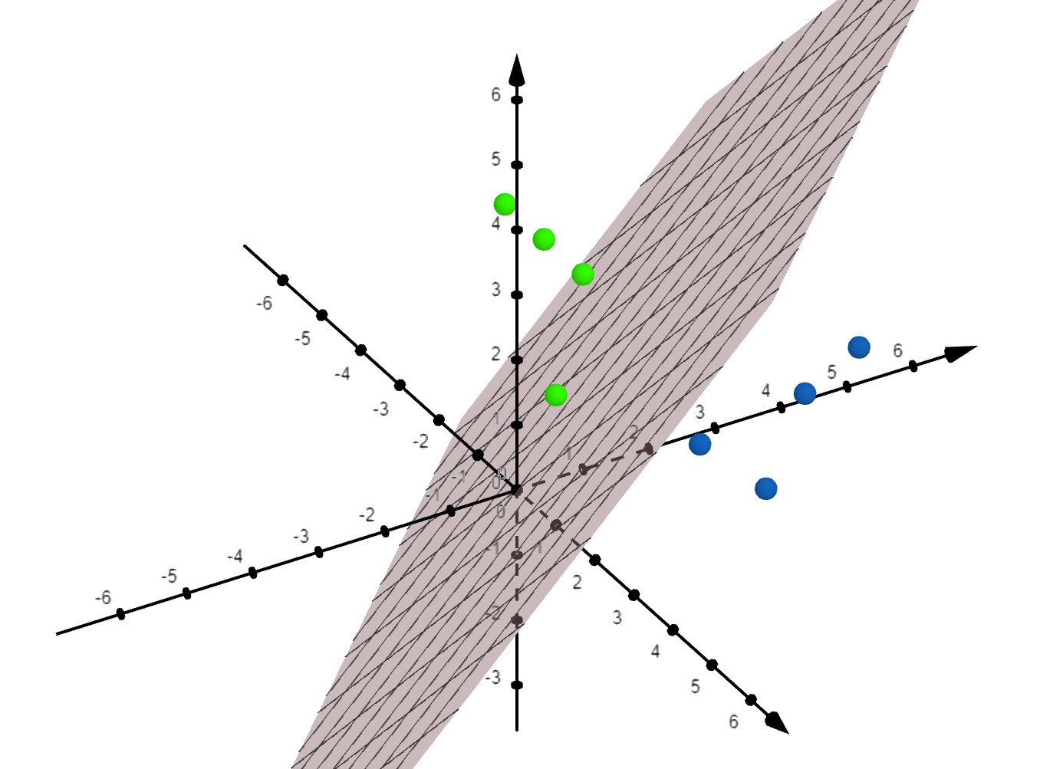
Manifold Hypothesis
Note first that I can easily separate this data with a simple, straight plane.

Slide 21
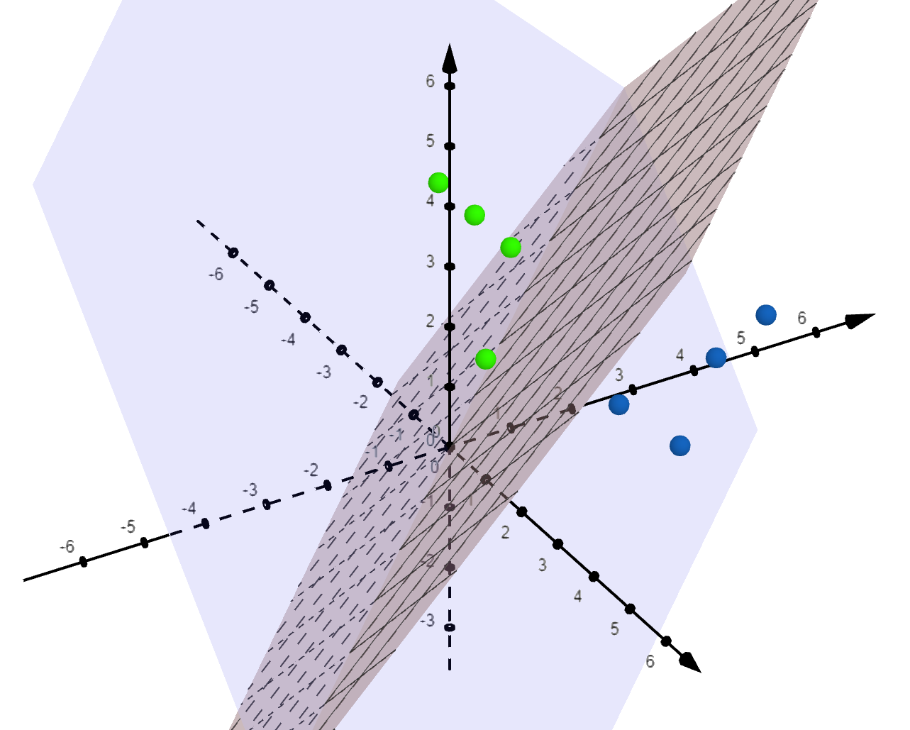
Manifold Hypothesis
Note first that I can easily separate this data with a simple, straight plane.
Then on an orthogonal (perpendicular) plane, I can project these points onto it.
Think of casting a light directly behind these points and the shadows hit that orthogonal plane.

Slide 22
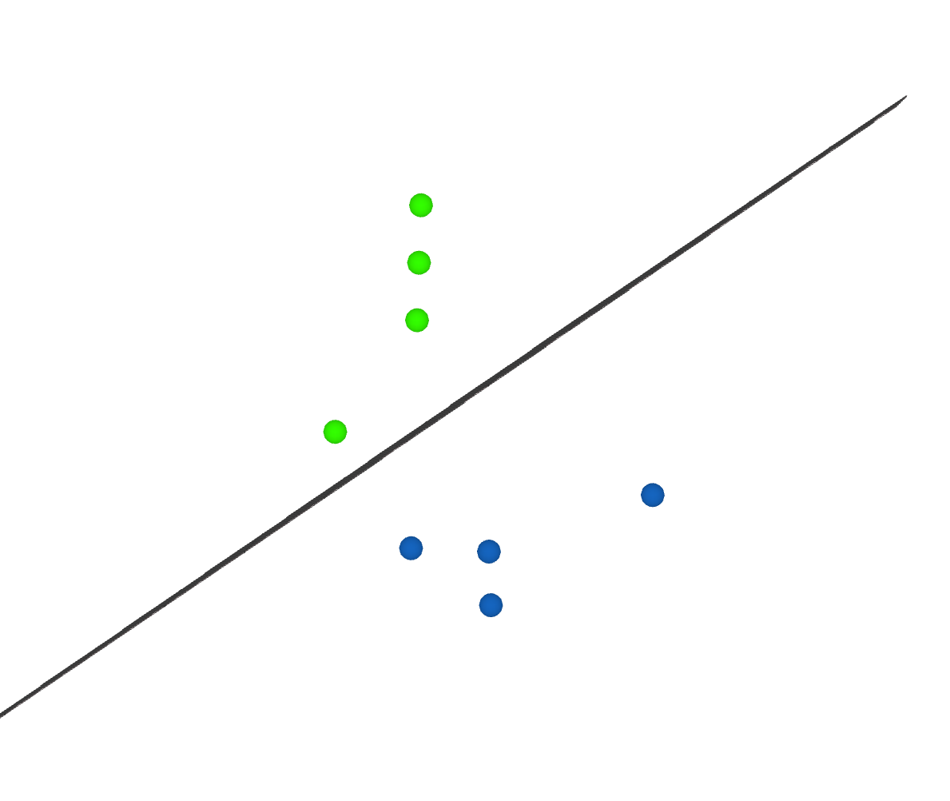
Manifold Hypothesis
Projecting those points onto that orthogonal plane, I now have reduced my 3-dimensional dataset into 2 dimensions.
I simplified my problem and notice my separating plane now turns into a separating line.
Assuming my training data was representative, I now have a model to predict new data points simply by using this line boundary.
https://www.geogebra.org/calculator/xujf9z9y

Slide 23
Manifold Hypothesis
The manifold hypothesis is a theory that high-dimensional data we observe in the real-world (e.g. images) can be effectively reduced to fewer dimensions using this manifold technique.
This assumption also states we can simplify models greatly using this technique.
Of course, if our data is biased or poorly sampled we can still overfit our manifolds making wrong predictions.
Doing several folds can also cause overfitting to our data.

Slide 24
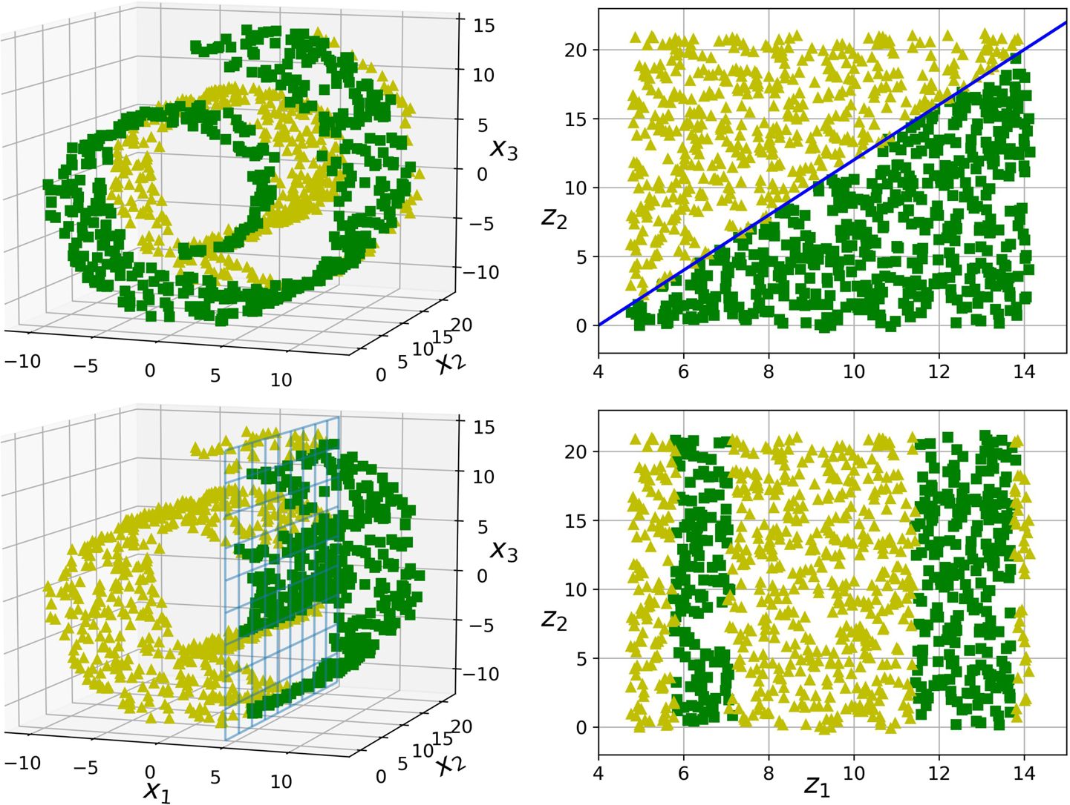
Manifold Hypothesis
Neural networks, principal component analysis (PCA), support vector machines, and several other “black box” machine learning algorithms perform manifold manipulation like this.
Of course, manifolds can be much more complex and require weird nonlinear flattening techniques, which is what neural networks effectively do.
To the right we see manifold manipulation to classify data points in the shape of a spiral, separating it into effective decision boundaries.

Slide 25
Learn More About Manifold Hypothesis
http://colah.github.io/posts/2014-03-NN-Manifolds-Topology/
https://youtu.be/e5xKayCBOeU

Slide 26
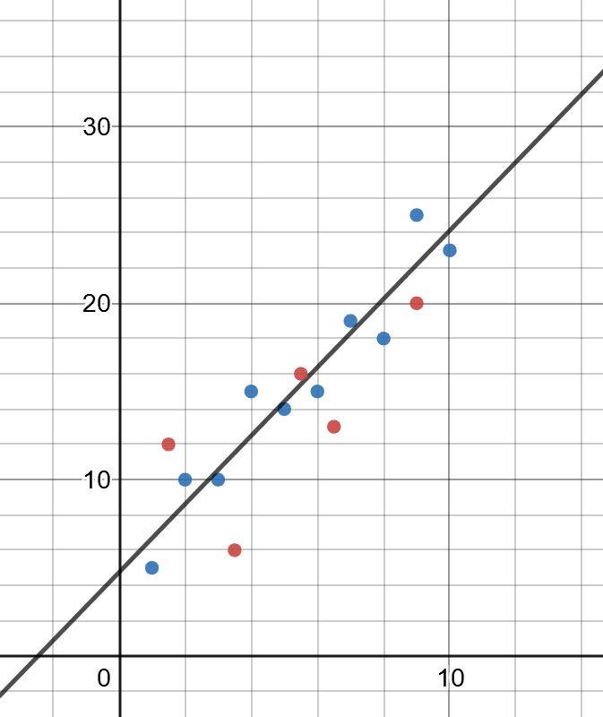
Training and Testing Data
A common practice to proactively prevent overfitting in machine learning is to separate training data and testing data.
Training data is data used to fit a model and is typically 2/3 of the data.
Test data is used to test the model and is the remaining 1/3 of the data.
By omitting the testing data from training, we see how well the model works on data it has not seen before and change our parameters accordingly.
DATA
TRAINING
TESTING

Slide 27
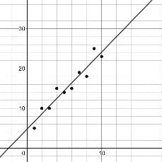
Cross-Validation
We can take this concept of training/testing data a step further, and test different combinations of training and testing data.
This is known as cross-validation, the gold standard of validation techniques.
To the right we have 3-fold cross validation which breaks the data into thirds and uses one of the pieces for testing.
We can then evaluate how well each of these perform, being able to compare different parameters and models (e.g. linear regression vs decision trees) and see which setup produces the best performance.
DATA
TRAINING
TRAINING
TESTING
TRAINING
TESTING
TRAINING
TESTING
TRAINING
TRAINING

Slide 28
Cross-Validation
We can take this concept of training/testing data a step further, and test different combinations of training and testing data.
This is known as cross-validation, the gold standard of validation techniques.
To the right we have 3-fold cross validation which breaks the data into thirds and uses one of the pieces for testing.
We can then evaluate how well each of these perform, being able to compare different parameters and models (e.g. linear regression vs decision trees) and see which setup produces the best performance.
DATA
TRAINING
TRAINING
TESTING
TRAINING
TESTING
TRAINING
TESTING
TRAINING
TRAINING

Slide 29
Cross-Validation
TRAINING
Note that k-fold cross validation allows us to slice our data into any number and not just 3 (typically 3, 5, or 10).
For example we can do 10-fold cross validation and validate 10 different combinations of training/test data.
The most extreme form of folding is leave-one-out cross validation, which omits one data record for testing and uses the remaining records for training, and this is done repeatedly.
TRAINING
TRAINING
TRAINING
TRAINING
TRAINING
TRAINING
TRAINING
TRAINING
TESTING

Slide 30
Random Fold Validation
As you may be noticing, machine learning often tries to overcome data variance with randomness.
A variant with fold validation is repeated random fold validation, where we randomly shuffle the data and create random train/test folds as many times as desired.
This is helpful when we need to mitigate variance in the model.
DATA

Slide 31
Which Validation to Use?
TRAINING
Generally, you will want to prefer k-fold validation as it is the gold standard.
A single train/test split might be warranted if performance of machine learning algorithm is slow and has enough data with lower bias.
Use the random fold split to mitigate variance in the model while balancing training speed and dataset sizes.
We will talk about class imbalance later, but if you do not have an equal number of samples for each class, you might want to consider using stratification in your k-fold validation.
Stratification means an equal proportion of data for each class is sampled for training and testing data (even it is sampled repeatedly), so that no class is neglected.
TESTING
TRAINING
TRAINING
TESTING
TRAINING
TESTING
TRAINING
TESTING
TRAINING
TRAINING

Slide 32
A Stratified Validation in Scikit-Learn
import numpy as np import pandas as pd # load data from sklearn.model_selection import train_test_split from sklearn.neural_network import MLPClassifier df = pd.read_csv(“https://tinyurl.com/y6r7qjrp”, delimiter=",") # Extract input variables (all rows, all columns but last column) # Note we should do some linear scaling here X = (df.values[:, :-1] / 255.0) + .01 # Extract output column (all rows, last column) Y = df.values[:, -1] # Get a count of each group to ensure samples are equitably balanced print(df.groupby(["class"]).agg({"class" : [np.size]})) # Separate training and testing data # Note that I use the 'stratify' parameter to ensure # each class is proportionally represented in both sets X_train, X_test, Y_train, Y_test = train_test_split(X, Y, test_size=.33, stratify=Y) nn = MLPClassifier(solver='sgd', hidden_layer_sizes=(100, ), max_iter=480, learning_rate_init=.1) nn.fit(X_train, Y_train) print("Training set score: %f" % nn.score(X_train, Y_train)) print("Test set score: %f" % nn.score(X_test, Y_test))

Slide 33
Validation Data
Validation is a separate type of testing data used to compare performance of different models.
When you are comparing two or more models (e.g. logistic regression versus decision trees), you may hold back one more chunk of data for validation.
It is different than the testing data, which is used to tune parameters of the individual model, not compare different models altogether.
The main idea behind validation data is being a final stopgap in case p-hacking and iterative parameter tuning leaked hints about the test dataset to the training algorithm.
DATA
TRAINING
TESTING
VALIDATION

Slide 34

Random Seeding
Machine learning deals with a lot of random-based operations:
Randomly sampled training/testing data
Random-based optimization and training (e.g. stochastic gradient descent, simulated annealing)
Randomly generated data from simulations
Testing can be challenging as the above operations make outputs nondeterministic, so setting a random seed is common practice to make them deterministic.
This allows tests to be conveniently reproducible, where sequences of randomly generated values are the same.
Be careful to not rely on random seeds too much! They can give the illusion of determinism so test many random seeds, not just one, to ensure they converge towards the same outcome.

Slide 35
Random Seeding a 3-Fold Split for Reproducibility
import pandas as pd from sklearn.linear_model import LogisticRegression from sklearn.model_selection import KFold, cross_val_score # Load the data df = pd.read_csv(“https://tinyurl.com/y6r7qjrp”, delimiter=",") X = df.values[:, :-1] Y = df.values[:, -1] # "random_state" is the random seed, which we fix to 7 kfold = KFold(n_splits=3, random_state=7, shuffle=True) model = LogisticRegression(solver='liblinear') results = cross_val_score(model, X, Y, cv=kfold) print("Accuracy Mean: %.3f (stdev=%.3f)" % (results.mean(), results.std()))

Slide 36


Why “Accuracy” is a Bad Measure for Classification
Suppose your machine learning model observed people with the name “Michael” quit their job.
Therefore it simply predicts any employee with the name “Michael” will quit, and everyone else will stay.
If there was one Michael in a company of 100 employees, but a different employee ended up quitting, the machine could still boast 98% accuracy.
Why stop there? If 99% of employees do not quit, you might as well predict every employee will not quit and get 99% accuracy.
Machine learning makes shortcuts like this all the time especially when the event of interest is rare (e.g. diseases, security breaches, employee attrition, rare road/highway events).
This employee quits
Prediction was wrong
But I’m still 98%
accurate!
Prediction
This employee is named “Michael”
This employee will quit

Slide 37
Confusion Matrix
As seen in the previous example, accuracy (the rate of correct labeling) can be a misleading measure of performance, especially in classification problems with class imbalance.
A better way to evaluate classification models is the confusion matrix, which keeps track of false positives (Type I Error) and false negatives (Type II Error).
We want to evaluate how many employees who were predicted to quit actually did quit (true positives).
Conversely, we also want to evaluate how many employees who were predicted to stay actually did stay (true negatives).
 | Actually Quits (True) | Actually Stays (False)
Predicted will quit (True) | 0 | 1
Predicted will stay (False) | 1 | 98

Slide 38
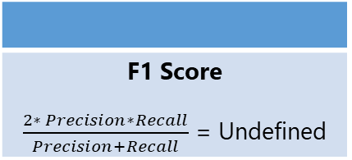
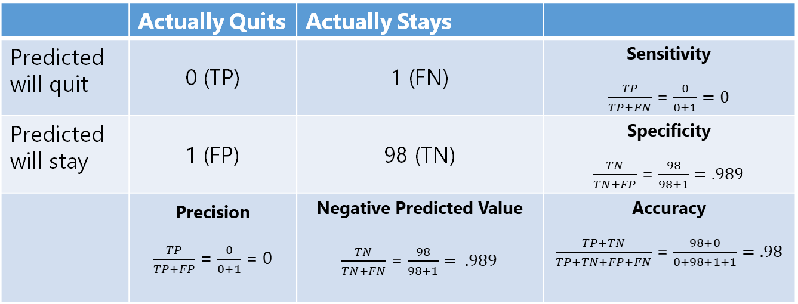
Confusion Matrix
From the confusion matrix, we can derive all sorts of useful metrics beyond just accuracy.
We can easily see that precision (how accurate positive predictions were) and sensitivity (rate of identified positives) are 0, meaning this machine learning model fails entirely at positive predictions.
 | Actually Quits | Actually Stays
Predicted will quit | 0 (TP) | 1 (FN) | Sensitivity $\frac{TP}{TP+FN}$ = $\frac{0}{0+1}=0$
Predicted will stay | 1 (FP) | 98 (TN) | Specificity $\frac{TN}{TN+FP}$ = $\frac{98}{98+1}=.989$
 | Precision $\frac{TP}{TP+FP}$ = $\frac{0}{0+1}$ = 0 | Negative Predicted Value $\frac{TN}{TN+FN}$ = $\frac{98}{98+1}= .989$ | Accuracy $\frac{TP+TN}{TP+TN+FP+FN}$ = $\frac{98+0}{0+98+1+1}=.98$
F1 Score $\frac{2∗ Precision∗Recall}{Precision+Recall}$ = Undefined

Slide 39
ROC and AUC
When we are evaluating different machine learning configurations, we may end up with dozens, hundreds, or thousands of confusion matrices.
These can be tedious to review, so we can summarize all of them with a receiver operator characteristic (ROC) curve as shown to the right.
This allows us to see each testing instance (each represented by a black dot) and find an agreeable balance between true positives and false positives.
True Positive Rate (Sensitivity)
False Positive Rate (1 - Specificity)

Slide 40
ROC and AUC
We can also compare different machine learning models by creating separate ROC curves for each.
For example, if our red curve represents a logistic regression and the blue curve represents a decision tree, we can see the performance of them side-by-side.
The area under the curve (AUC) is a good metric for choosing which model to use. Since the red curve (logistic regression) has a greater area, this suggests it is a superior model.
True Positive Rate (Sensitivity)
False Positive Rate (1 - Specificity)

Slide 41
Scenario: Validating a Model
import pandas as pd
import tensorflow as tf
from sklearn.model_selection import train_test_split
from sklearn.metrics import confusion_matrix
data = pd.read_csv("https://tinyurl.com/y2qmhfsr")
# Extract the input columns, scale down by 255
X = (data.iloc[:, 0:3].values / 255.0)
Y = data.iloc[:, -1].values
# Split train and test data sets
X_train, X_test, Y_train, Y_test = train_test_split(X, Y, test_size=1/3)
# declare the model
model = tf.keras.models.Sequential([
tf.keras.layers.Dense(3, activation='relu'),
tf.keras.layers.Dense(1, activation='sigmoid')
])
loss_fn = tf.keras.losses.MeanSquaredError()
# compile the model
model.compile(optimizer='adam',
loss=loss_fn,
metrics=['accuracy'])
# fit the model
model.fit(X_train, Y_train, epochs=100, batch_size=32)
# evaluate the model
scores = model.evaluate(X_test, Y_test, verbose=0)
print(f"Test Dataset Score: {scores[1]}")
# Predict on test dataset
predictions = model.predict(X_test) >= .5
# Build confusion matrix
matrix = confusion_matrix(
y_true=Y_test,
y_pred=predictions,
normalize=None
)
print(matrix)
https://katacoda.com/orm-thomas-nield/courses/oreilly-deep-learning-beginners/02-train-test-splits

Slide 42
Exercise 5

Slide 43
Validation Pitfalls

Slide 44
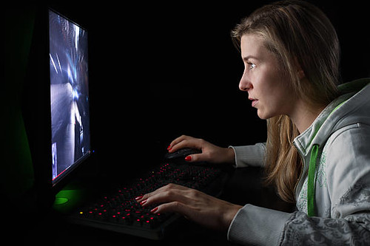
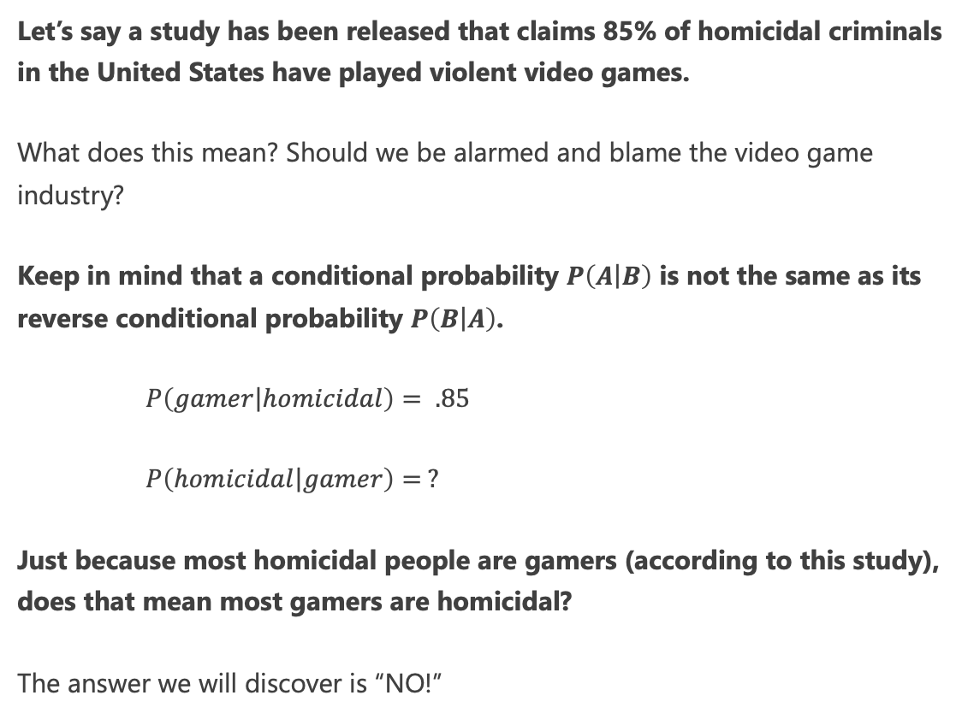
Violence and Video Games
Let’s say a study has been released that claims 85% of homicidal criminals in the United States have played violent video games.
What does this mean? Should we be alarmed and blame the video game industry?
Keep in mind that a conditional probability $P\left(\left.A\right|B\right)$ is not the same as its reverse conditional probability $P\left(\left.B\right|A\right)$.
$P\left(\left.gamer\right|homicidal\right)= .85$
$P\left(\left.homicidal\right|gamer\right)= ?$
Just because most homicidal people are gamers (according to this study), does that mean most gamers are homicidal?
The answer we will discover is “NO!”
This Photo is licensed under CC BY

Slide 45
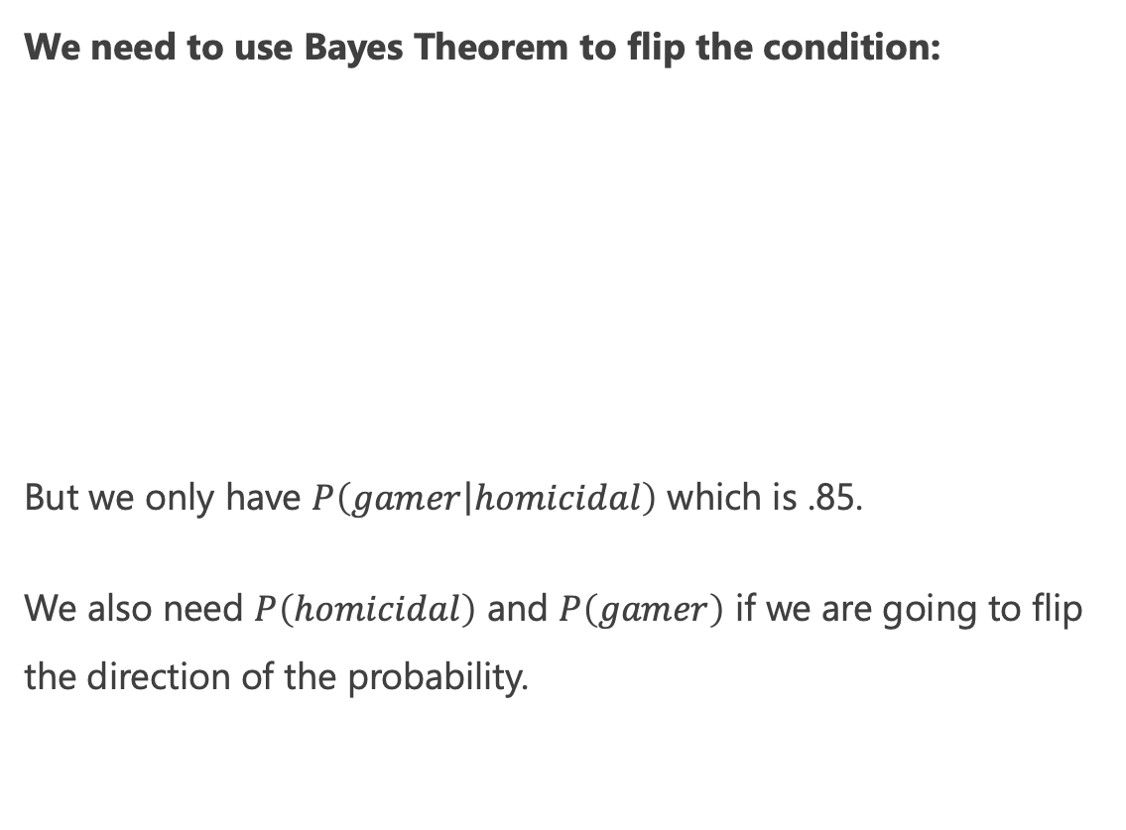
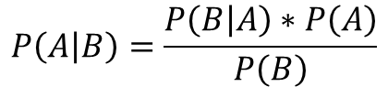
Violence and Video Games
We need to use Bayes Theorem to flip the condition:
But we only have $P\left(\left.gamer\right|homicidal\right)$ which is .85.
We also need $P\left(homicidal\right)$ and $P\left(gamer\right)$ if we are going to flip the direction of the probability.
$$P\left(\left.A\right|B\right)=\frac{P\left(\left.B\right|A\right)∗P\left(A\right)}{P\left(B\right)}$$
$$P\left(\left.homicidial\right|gamer\right)=\frac{P\left(\left.gamer\right|homicidal\right)∗P\left(homicidal\right)}{P\left(gamer\right)}$$
This Photo is licensed under CC BY

Slide 46
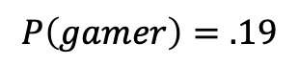
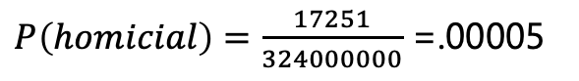
Violence and Video Games
Sometimes it can be hard to get these other probabilities, but with population studies a little bit of research might give us some numbers.
According to the FBI, there are 17,251 known homicidal offenders in 2017 and according to Wolfram Alpha there are 324 million people in the United States.
Gathering data from video game industry market research, you estimate that 19% of the population plays violent video games.
This Photo is licensed under CC BY
$P\left(homicial\right)=\frac{17251}{324000000}$ =.00005
$$P\left(gamer\right)=.19$$

Slide 47
Discovering Bayes Theorem
Unlike the media and politicians, we continued doing the math and research and found 19% of the population plays violent video games, and .005% of the population is homicidal.
We can use Bayes Theorem to merge these probabilities together.=
P(Homicidal if Gamer) = P(Gamer if Homicidal) * P(Homicidal) / P(Gamer)
P(Homicidal if Gamer) = (.85 * .00005) / .19
P(Homicidal if Gamer) = 0.0002
Wow! So if you take any gamer there is only a .02% chance they are homicidal.
This number is much different than the 85% probability a homicidal criminal is a gamer.
This Photo is licensed under CC BY

Slide 48
Discovering Bayes Theorem
So according to Bayes Theorem, a person who plays violent video games is only .02% likely to be violent compared to a non-gamer who is .005% likely.
This number is much less significant than the 85% statistic, and shows how subtle but drastic the difference is between “What is the probability of A given B?” versus “What is the probability of B given A?”
But the media can spin that saying “gamers are 4x more likely to be homicidal” when in actuality, we are comparing small numbers to small numbers.
In other words, we should not take a common trait (playing video games, liking ice cream) and associate it with an uncommon one (being homicidal).
This Photo is licensed under CC BY

Slide 49
Visualizing Bayes Theorem (Not to Scale)
Entire Population (100,000)
Plays Violent Video Games
(12,000)
Homicidal
(5)

Slide 50

Bayes and the Confusion Matrix
A medical technology AI startup approaches your organization and says they have an “AI system” that takes a small blood sample, assays several variables, ensembles machine learning algorithms, and predicts a health risk (simply categorized as “AT RISK” or “NOT AT RISK”).
The vendor says that 99% of patients who are at risk will test positive.
Is this significant and credible? Why or why not? What should our next questions be?

Slide 51
Bayes and the Confusion Matrix
There is still some missing information you will have to solicit from the vendor.
We are told that for patients that have health risk, 99% will be identified successfully (sensitivity).
But what if we flip the question? What percentage of those who tested positive have the health risk (precision)?
The vendor goes back to their research team and returns with a confusion matrix of 1000 patients they tested.
They give you an answer: 198 / (198 + 50) = 79.8%

Slide 52
Bayes and the Confusion Matrix
With this confusion matrix, we indeed see 99% of those who are at risk test positive, and that 79.8% of those tested positive are at risk. We found the conditional probability in both directions.
Despite these numbers, you start to feel uncomfortable that you are not using outside data beyond the vendor’s test.
What else can we do to verify the vendor’s claims and testing results?

Slide 53
Bayes and the Confusion Matrix
After some Wikipedia research, you discover something pivotal…
Only 1% of the population is at risk.
This means if you planned on deploying this test to 100K patients, only 1000 are likely at risk.
The vendor advertised a 99% true positive rate. You now wonder: will the vendor’s product single out these 1000 patients? Out of 100K? Without error?

Slide 54
Bayes and the Confusion Matrix
If you feel like something is off because only 1% of the population has the health risk, but 20% of the test patients do, you would be right.
Utilizing Bayes Theorem, we can incorporate this 1% statistic to find the true probability of being at risk if tested positive.
P(At Risk if Positive) = P(Positive if at risk) * P(At risk) / P(Positive)
P(At Risk if Positive) = (.99 * .01) / .248
P(At Risk if Positive) = .0339
3.39% is now the probability of risk given a positive test. How did it drop from 99% to 3.39%?

Slide 55
Bayes and the Confusion Matrix
3.39% is now the probability of risk given a positive test. How did it drop from 99% to 3.39%?
This just shows how easily we can get duped by probabilities that are only high in a specific population like the vendor’s 1000 test patients (remember the homicides and video games example)?
So if this test only has a 3.39% probability of successfully identifying a true positive, we probably should not use it.

Slide 56
P-Values and Statistical Significance
DISCUSSION: what does it mean when someone says an outcome is “statistically significant?”
A p-value is the probability that you have gotten an outcome by random luck, rather than because of a hypothesized variable.
The p-value was invented by Ronald Fisher in 1925, and it is best demonstrated in his party experiment:¹
A colleague claimed she could detect when tea was poured before milk, so he made her 8 cups of tea as an experiment.
4 had milk poured first, the other 4 had tea poured first.
She identified them all correctly, and the probability of this happening by chance is 1 in 70, or 0.01428571, which is the P-value.
Conventionally a p-value of .05 or less is considered statistically significant, although this arbitrary heuristic has come under scrutiny as data availability has commoditized research.
[1] https://www.pbs.org/wgbh/nova/video/what-is-a-p-value/

Slide 57
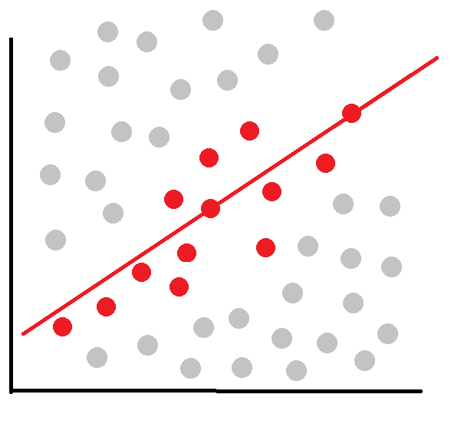
P-Hacking
P-hacking is cherry-picking models and data that produces a desired result rather than a realistic one.
P-hacking is data mining for a p-value of less than .05
Undisciplined and pressured practices are often the cause.
Simply choosing a model because “it looks significant” or “solves my objective”, rather than challenging it, is a subtle and easy way to p-hack.
This can lead to an inflation of false positives, where our model becomes too optimistic about an outcome but performs poorly in the wild.
P-hacking is allegedly responsible for the replicability crisis¹, and is arguably made worse with the availability of data and machine learning.
[1] Ioannidis JP. Why most published research findings are false. PLoS Med. 2005;2(8):e124. doi:10.1371/journal.pmed.0020124

Slide 58
P-Hacking
Examples of P-Hacking:
Collecting just enough data to get a desired result.
Removing inconvenient data as “outliers” or “noise”
Shopping for variables that give a desired result
Dividing data into sub-groups, and focusing on one group
Shopping model parameters that give the right result
Using random seeds that produce desired outcomes
Motivations for P-Hacking:
Research pressure: “No paper, no funding”
Job pressure: “Our client wants to see a model that predicts 10% savings in transportation costs”
Startup pressure: “Our VC investors want a demonstration, so find a dataset that will produce favorable results.”
Is P-hacking malicious and deceptive? Not usually, it is often human nature operating under pressure and career survival.

Slide 59
P-Hacking
“If you torture the data long enough, it will confess.”
― Ronald H. Coase, Essays on Economics and Economists
“Look! I found a positive correlation!”

Slide 60
Production Concerns

Slide 61
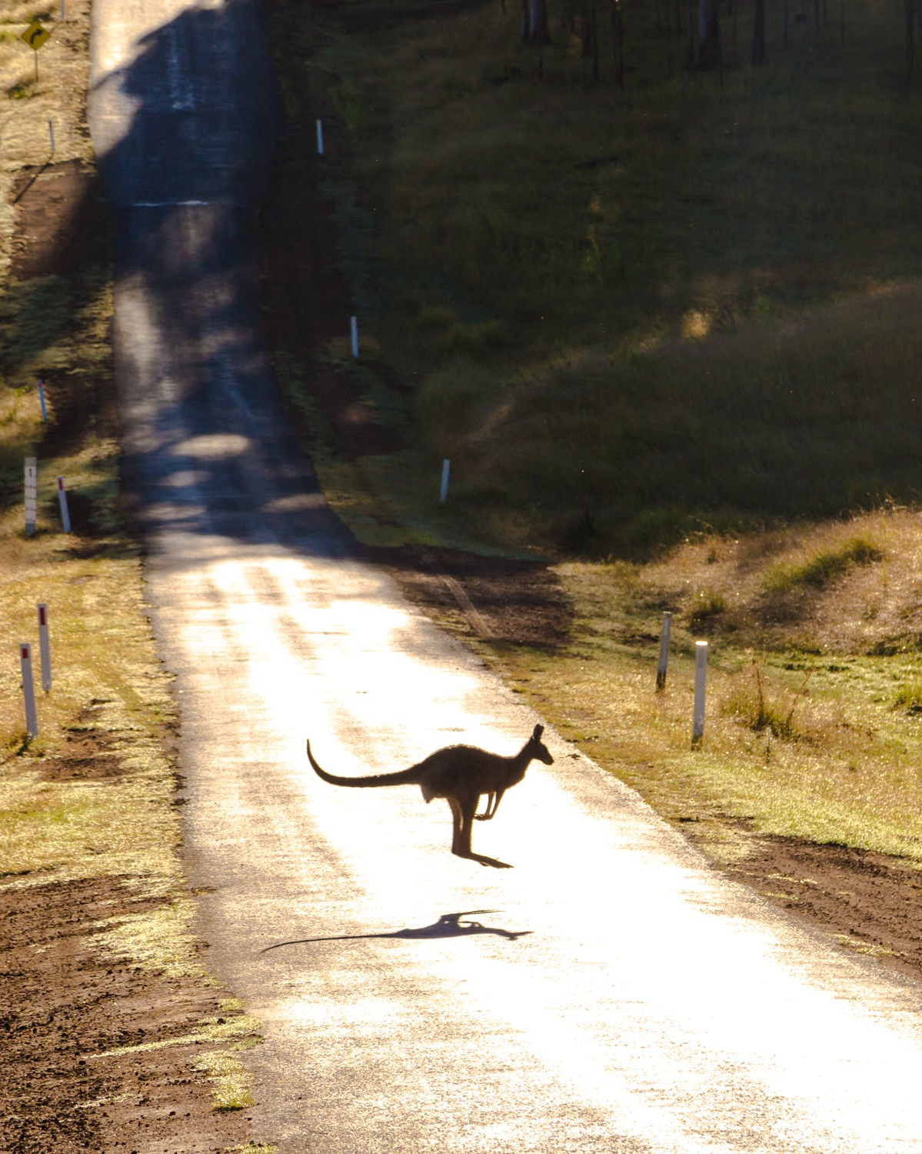
Going Out in the Wild: Selection Bias
Despite best efforts to train and test models effectively, things can still go wrong once you release a system into the wild.
A self-driving car system may have been trained to recognize pedestrians and even deer, but what if it was never trained to recognize a kangaroo?
This is exactly what happened to Volvo when they tested their autonomous vehicles in Australia.
The kangaroo was not recognized, and its jumping motion thwarted the object trajectory prediction.
A kangaroo is an example of selection bias, something never captured in the training dataset and heuristics due to selection being too local or not representative of the larger domain.

Slide 62
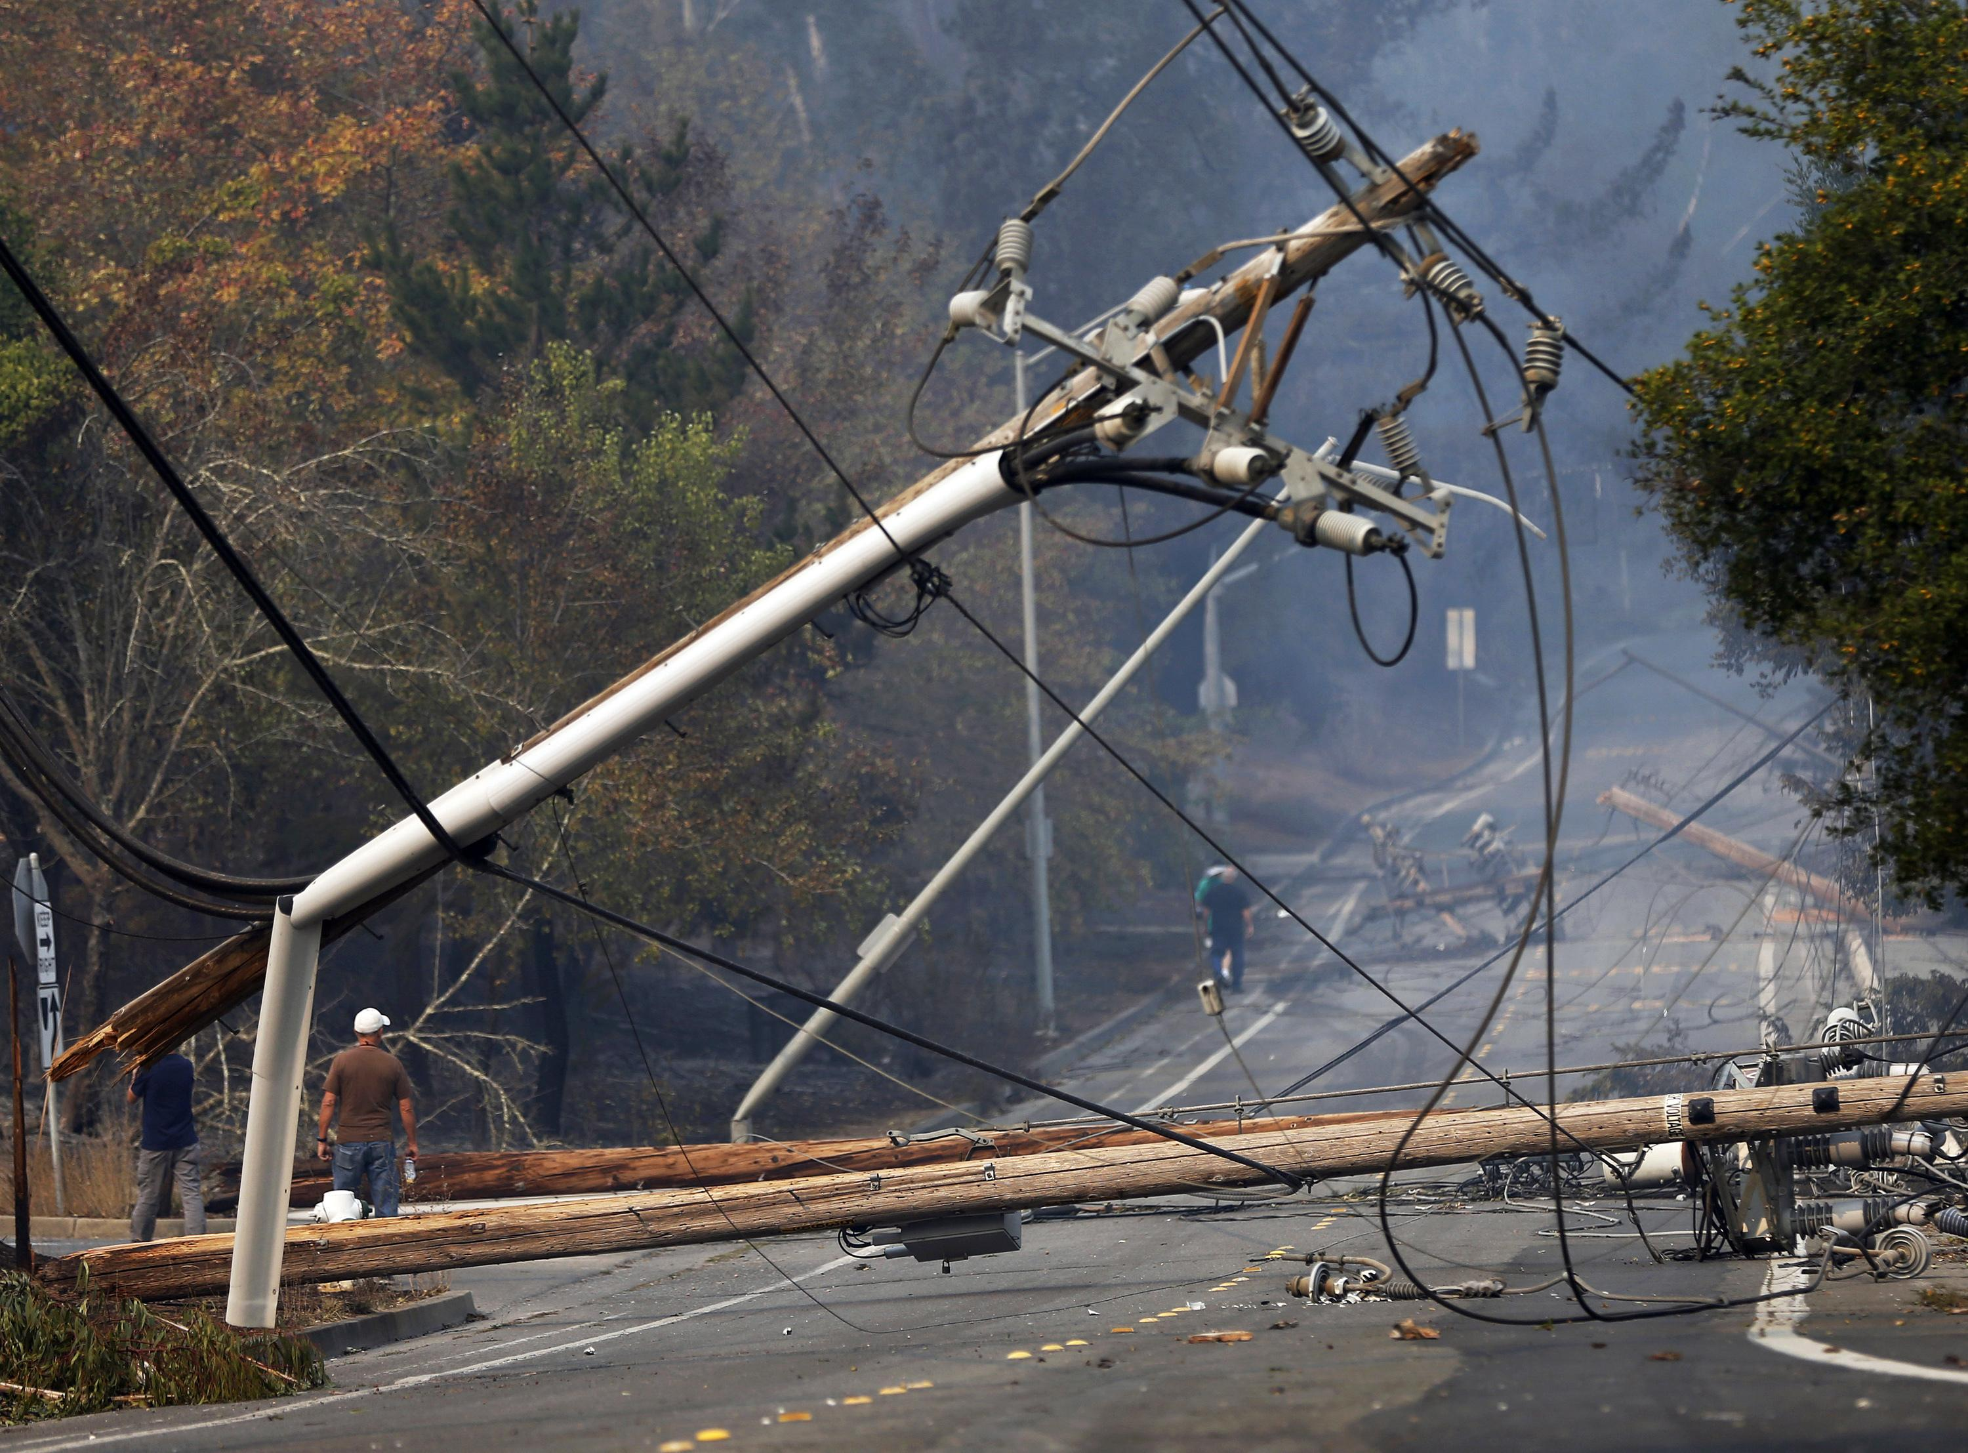
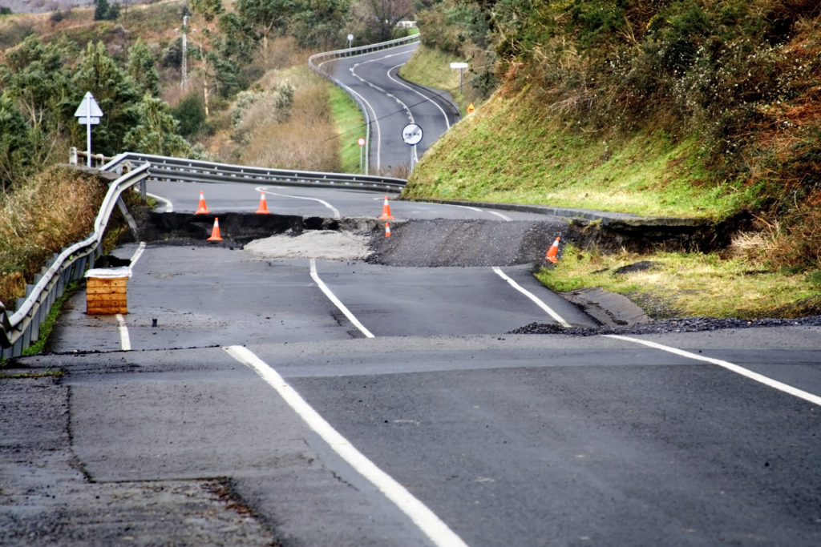
Going Out in the Wild: The Problem with Outliers
Another problem is outliers, or unlikely events, that were not captured in training data.
EXAMPLES: a fallen power line, a broken stoplight, a stop sign obscured by a tree, a locust storm, an exotic escaped zoo animal.
The law of truly large numbers states that with a large enough domain, any outrageous thing (an outlier) is likely to be observed.
Even untested combinations of normal conditions can create outliers (e.g. stop sign with graffiti during rainy weather).
Our training data set can only sample so much, and in the wild the volume of outliers is going to be high.
To make matters worse, we must deal with class imbalance for every outlier case!

Slide 63
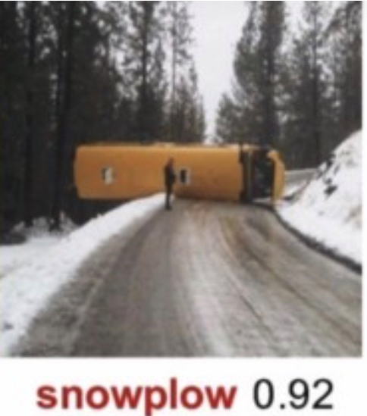
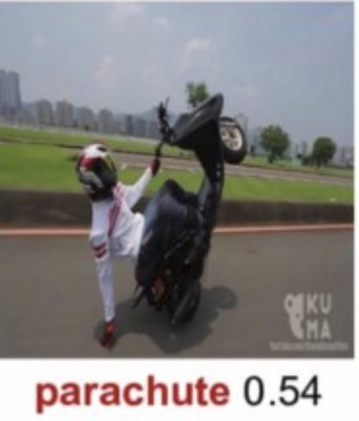
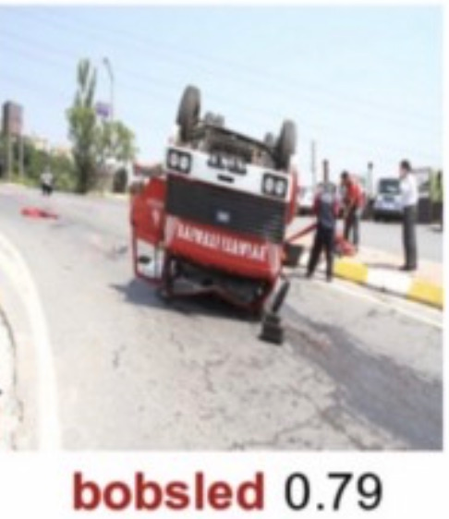
Going Out in the Wild: The Problem with Outliers
To the right are examples of a well-trained neural network unable to recognize images correctly due to road objects in abnormal positions.
SOURCE: https://arxiv.org/abs/1811.11553

Slide 64
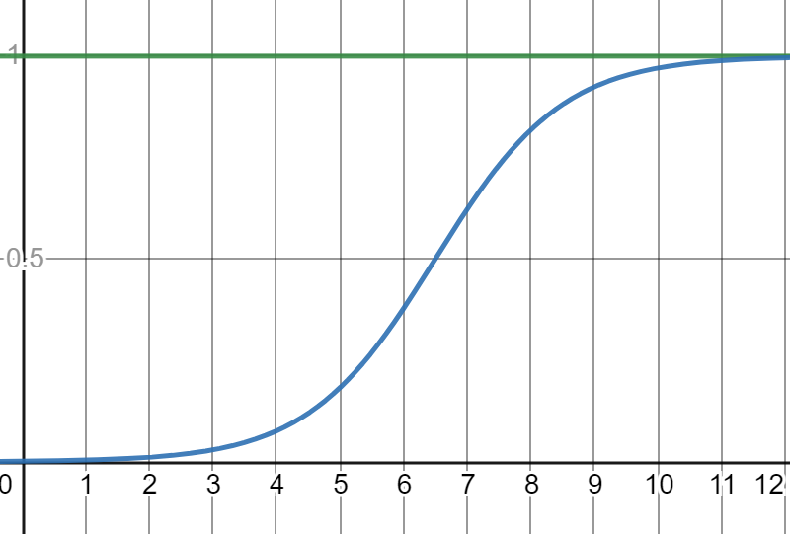
Going Out in the Wild: The S-Curve
Stefan Seltz-Axmacher (CEO of defunct Starsky Robotics) shared an interesting industry insight on AI capability.
Take an “AI” system like virtual assistants (e.g. Alexa, Siri) or fully autonomous vehicles; many popularly believe that AI capability is exponential much akin to Moore’s Law, but it is in fact a logistic S-curve.
Time and expense is invested to create an “AI” with more skills, hoping to nearly reach 100% coverage of desired capabilities.
The logistic curve to the right shows an ideal situation where enough time and expense shows a nearing of 100% skills coverage.
Is this realistic though?
100%
Skill Coverage
Time/Expense
https://medium.com/starsky-robotics-blog/the-end-of-starsky-robotics-acb8a6a8a5f5
http://www.autonocast.com/blog/2020/3/27/181-stefan-seltz-axmacher-on-the-end-of-starsky-and-the-future-of-autonomy

Slide 65
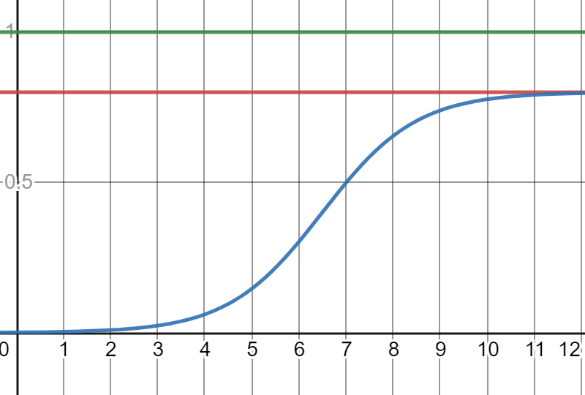
Going Out in the Wild: The S-Curve
To the right is a more realistic outcome, where skill coverage converges on a much lower ceiling than 100%.
This is the largest problem with the “AI” industry.
Several tech companies building “AI systems” found that several skills can be added in stride with initial expense, but a diminishing return for “cost per new skill added” is ultimately encountered.
Due to computational and training data limits, and the high volume of outlier cases, it becomes practically impossible to create an “AI” that nears 100% coverage of needed skills without exponential expense.
This demonstrates that it is not AI capability that is exponential, but rather the expense to make it.
100%
80%
Skill Coverage
Time/Expense
https://medium.com/starsky-robotics-blog/the-end-of-starsky-robotics-acb8a6a8a5f5
http://www.autonocast.com/blog/2020/3/27/181-stefan-seltz-axmacher-on-the-end-of-starsky-and-the-future-of-autonomy

Slide 66
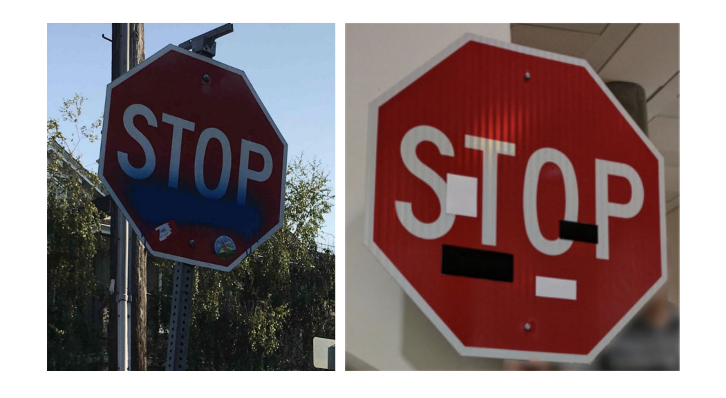
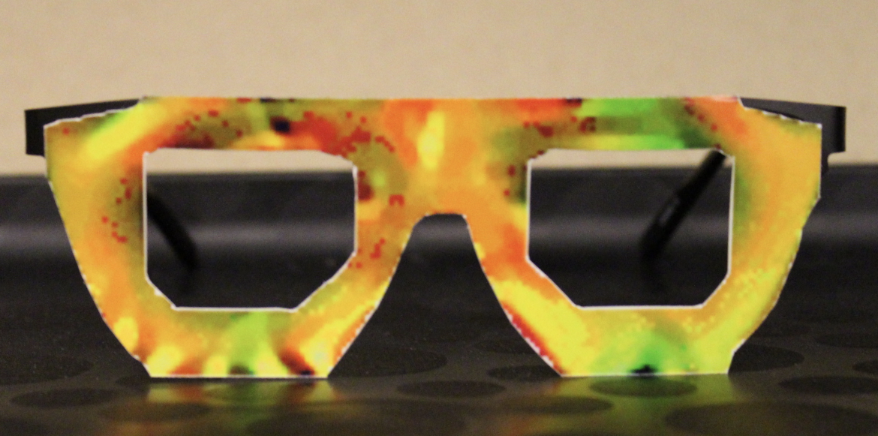
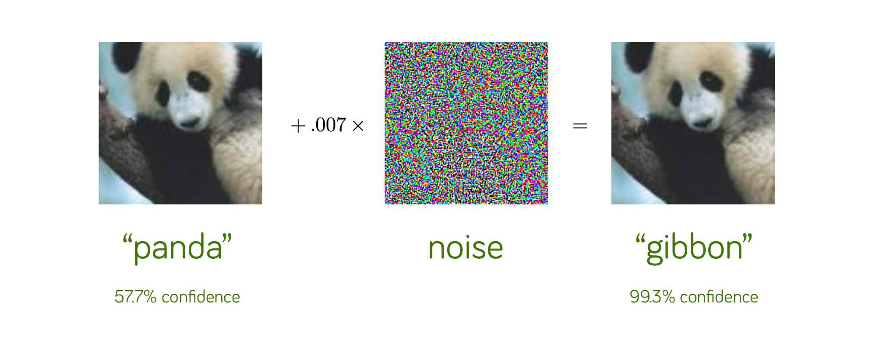
Going Out in the Wild: Adversarial Attacks
If biased sampling and outliers are not enough of a challenge, consider cases where synthetic outliers are created.
A stop sign with malicious stickers is identified as a “45 MPH” sign.
Pixelated face wear and photos of other people can thwart facial recognition software.
Pixelated noise on a panda photo can misclassify it as a gibbon.
Children in Halloween costumes are not recognized as pedestrians.
Adversarial attacks are hard to mitigate, and the only surefire solution is preventing exposure to uncontrolled environments or engineering safeguards to reasonable risk acceptance levels.

Slide 67
Going Out in the Wild: The Problem with Outliers
The million-dollar question: so how do we deal with outliers?
Are we ever going to collect enough data to effectively identify outliers? Compensate for data gaps?
Maybe the answer is “it depends”:
If the domain is narrow and controlled enough, maybe we can collect enough data or create explicit rules that do not rely on data.
If the domain is broad and uncontrolled, consider safe “guardrail” heuristics when an outlier is encountered, or request a human operator to take over.
In uncontrolled domains, find effective inputs and heuristics that are reliable and make sense for a given application (e.g., radar being used to emergency brake for an obstacle).

Slide 68
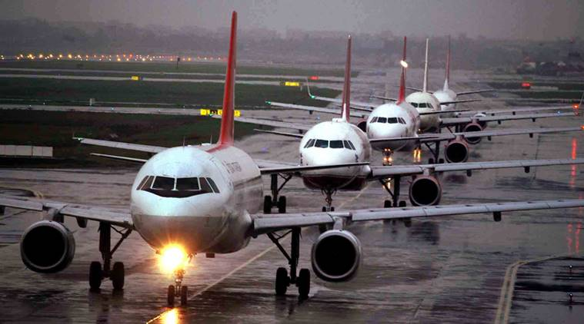

Going Out in the Wild: Data Rot
Data used to train a model can work for awhile, but the data is likely to become stale (known as data rot).
The world will change, trends will come and go, and nothing will stay the same which renders captured data obsolete.
Airport congestion data from 2016 is hardly relevant in 2020 as new terminals, airline presence, construction projects, unusual weather seasons, and other factors disrupt.
Something as unpredictable as clothing fashions can cause problems with image recognition.
Even changes to camera resolution, hardware configurations, lighting, correction filters, and picture quality can cause training data to become outdated (contemplate this when budgeting for data acquisition!)

Slide 69
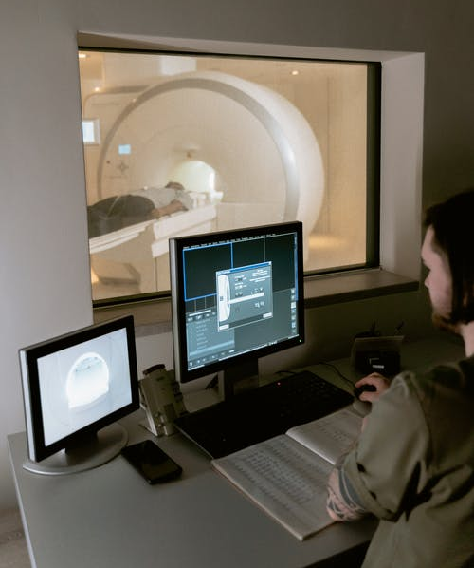
Going Out in the Wild: Data Rot
“It turns out that when we collect data from Stanford Hospital, then we train and test on data from the same hospital, indeed, we can publish papers showing [the algorithms] are comparable to human radiologists in spotting certain conditions.
“It turns out [that when] you take that same model, that same AI system, to an older hospital down the street, with an older machine, and the technician uses a slightly different imaging protocol, that data drifts to cause the performance of AI system to degrade significantly. In contrast, any human radiologist can walk down the street to the older hospital and do just fine.
“So even though at a moment in time, on a specific data set, we can show this works, the clinical reality is that these models still need a lot of work to reach production.”
- Andrew Ng, Former Head of Google Brain and Deep Learning Education Pioneer
https://spectrum.ieee.org/view-from-the-valley/artificial-intelligence/machine-learning/andrew-ng-xrays-the-ai-hype

Slide 70
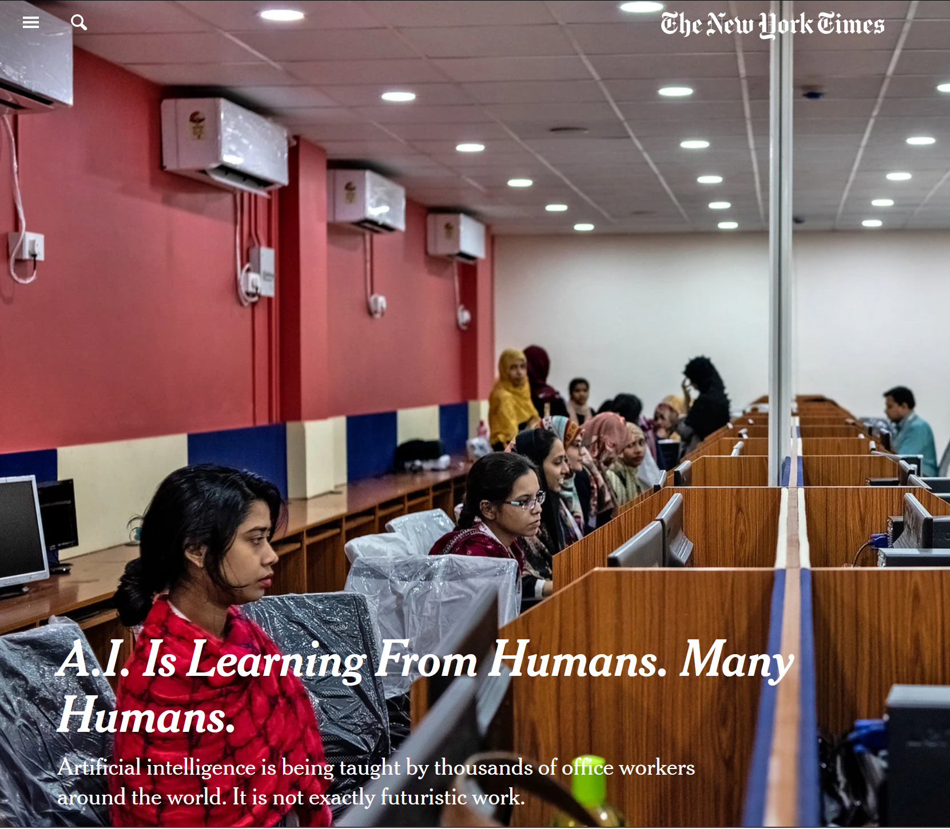
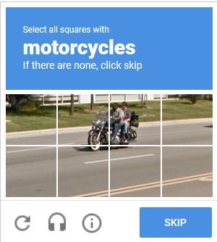
Going Out in the Wild: Data Entry and Correction
An open secret with machine learning projects is they require a massive amount of labeled data, and this is often a manual effort.
If labeled data does not exist, you are going to have a difficult/expensive time creating and updating it.
Tech companies rely on massive data entry workforces that label images, medical scans, traffic scenarios, social media content, and other data.
This task is done manually by tens of thousands of low-cost data entry workers.
Smaller AI startups must allocate a substantial part of their budget for this kind of labor.
Before embarking on a data DL project make sure that necessary data will be available, and there is budget to effectively to obtain/create it.
New York Times wrote about the massive data entry labor required to make “AI” work.
https://www.nytimes.com/2019/08/16/technology/ai-humans.html
Google’s reCAPTCHA, used to verify a user is human, is used to label machine learning datasets for machine learning research.
https://www.google.com/recaptcha/intro/v3.htm

Slide 71

Going Out in the Wild: The Gap
“Those of us in machine learning are really good at doing well on a test set, but unfortunately deploying a system takes more than doing well on a test set.
“All of AI, not just healthcare, has a proof-of-concept-to-production gap. The full cycle of a machine learning project is not just modeling. It is finding the right data, deploying it, monitoring it, feeding data back [into the model], showing safety—doing all the things that need to be done [for a model] to be deployed. [That goes] beyond doing well on the test set, which fortunately or unfortunately is what we in machine learning are great at.”
- Andrew Ng, Former Head of Google Brain and Deep Learning Education Pioneer
https://spectrum.ieee.org/view-from-the-valley/artificial-intelligence/machine-learning/andrew-ng-xrays-the-ai-hype

Slide 72
Deep Learning in Larger Systems

Slide 73
Modular versus End-to-End Systems
An aspect to categorize machine learning systems are modular versus end-to-end.¹
Modular systems “divide-and-conquer” driving into separate tasks (some using machine learning) to create a software pipeline, such as “self-driving” cars properly known as advanced driving systems (ADS).
End-to-end systems are often pure machine learning, ingesting sensor readings and outputting vehicle actions via deep supervised or deep reinforcement learning.
Modular systems are more prevalent and practical than end-to-end systems, as they are more interpretable and performant.
Environment
Environment
Sensors
Sensors
Modules
End-to-End
Black Box
Object Tracking
Localization
Environment Modeling
Prediction
Human-Machine Interface
Vehicle Action
Vehicle Action
SOURCE: Yurtsever, E., Lambert, J., Carballo, A., & Takeda, K. (2020). A survey of autonomous driving: Common practices and emerging technologies. IEEE Access, 8, 58443-58469.

Slide 74
Modular versus End-to-End Systems
“If you have a sufficiently large deep learning model, and you train it on a dense sampling of the input-cross-output space for a task, then it will learn to solve the task, whatever that may be — [video games] Dota, StarCraft, you name it. It’s tremendously valuable. It has almost infinite applications in machine perception problems. The only problem here is that the amount of data you need is a combinatorial function of task complexity, so even slightly complex tasks can become prohibitively expensive.
“Take self-driving cars, for instance. Millions upon millions of training situations aren’t sufficient for an end-to-end deep learning model to learn to safely drive a car. Which is why, first of all, [Level 5] self-driving isn’t quite there yet. And second, the most advanced self-driving systems are primarily symbolic models that use deep learning to interface these manually engineered models with sensor data. If deep learning could generalize, we’d have had L5 self-driving in 2016, and it would have taken the form of a big neural network.”
-Francis Chollet, AI Researcher at Google and creator of Keras Tensorflow
Environment
Environment
Sensors
Sensors
Modules
End-to-End
Black Box
Object Tracking
Localization
Environment Modeling
Prediction
Human-Machine Interface
Vehicle Action
Vehicle Action
[1] https://www.theverge.com/2019/12/19/21029605/artificial-intelligence-ai-progress-measurement-benchmarks-interview-francois-chollet-google

Slide 75


End-to-End Systems
Many people falsely believe that deep learning is central to “self-driving cars” on the road, but this is not true in practice.
There has been academic research using supervised deep learning, deep reinforcement learning, and neuroevolution to completely drive end-to-end with machine learning.¹
These systems can perform on country roads and other predictable domains but have not worked well in urban environments.
Think of end-to-end as shoveling all sensor data (LIDAR, radar, camera) into a single neural network black box, and not having rules, safeguards, transparency, or sanity checks coded around it.
We just let it blindly crunch numbers and hope “it learns.”
Environment
Sensors
CLASSIFY DATA…
BRAKE!
End-to-End
Black Box
Vehicle Action
SOURCE: Yurtsever, E., Lambert, J., Carballo, A., & Takeda, K. (2020). A survey of autonomous driving: Common practices and emerging technologies. IEEE Access, 8, 58443-58469.

Slide 76
End-to-End Systems
End-to-end systems have practical challenges, which is why “self-driving” vendors/manufacturers use modular systems.¹
Supervised deep learning trains itself based on human driver data (e.g. Tesla) but it does not generalize well, and locale datasets become a key strategy.
Deep reinforcement learning learns the optimal way to drive, but either requires simulation or constant online data entry to “correct” actions and even then, it does not perform.
Safety and interpretability features are virtually non-existent due to lack of modules.
Getting a ground truth dataset, or a training dataset that perfectly captures human driver behavior (or any ideal model behavior) is also a barrier.
Environment
Sensors
CLASSIFY DATA…
BRAKE!
End-to-End
Black Box
Vehicle Action
SOURCE: Yurtsever, E., Lambert, J., Carballo, A., & Takeda, K. (2020). A survey of autonomous driving: Common practices and emerging technologies. IEEE Access, 8, 58443-58469.

Slide 77
Modular Systems
Modular systems have many benefits, separating different tasks and putting them together in a controlled and interpretable manner.
Certain components like object tracking and rectangular bounding are done with machine learning modules, but the rest of the system will use heuristics, rules, and coded safeguards.
This makes the system much more maintainable and allows injecting rules while separating safety functions.
EXAMPLE: Uber’s system would detect and classify objects like pedestrians and cyclists using machine learning, then a heuristic module would perform path prediction, and a third module would plan maneuvers to avoid that path.¹
The downside is code complexity, and errors must be captured before they propagate to other modules.
Environment
Sensors
TRACKING...
SIZING BOX
Modules
Object Tracking
Localization
PATH:
LEFT
Environment Modeling
LABEL:
PEDESTRIAN
Prediction
Human-Machine Interface
Vehicle Action
[1] https://dms.ntsb.gov/public/62500-62999/62978/629713.pdf

Slide 78
Reinforcement Learning
Reinforcement learning marries machine learning and simulations, where simulations generate data and ML finds the right simulation parameters to pursue desired outcomes.
Example: An end-to-end simulation may virtually crash a vehicle thousands of times until it “learns” not to crash (adjusting the right weight parameters).
Example simulation: virtual radar sensors measure distances to obstacles and inputs them into a neural network.
The neural network receives obstacle distances during the simulation, and outputs an action to either TURN LEFT or TURN RIGHT.
Weights are iteratively adjusted until the vehicle does not crash anymore, although it may fail in tracks it never encountered before.
As we will learn in the next section, end-to-end reinforcement learning is not used in practice for real-world vehicle automation but it can play a modular role.
Obstacle detected
Turn left

Slide 79
The Simulation-to-Reality Gap
Even though simulations are imperfect and hardly capture real-world variability, they are sometimes the only tool available.
The gap between clean, idealistic simulations (with limited variables) versus reality (with infinite, messy variables) is known as the simulation-to-reality gap.
“Self-driving” cars are trained on real roads, but most data are gathered from simulations due to practicality and cost.
Collecting data on crash outcomes is critical, and while crashes are perfectly acceptable on simulations, it is not in the real world.
While some simulations can be quite robust (FAA-approved flight simulators), it is prudent to be informed of their limitations.
CLEAR!

Slide 80
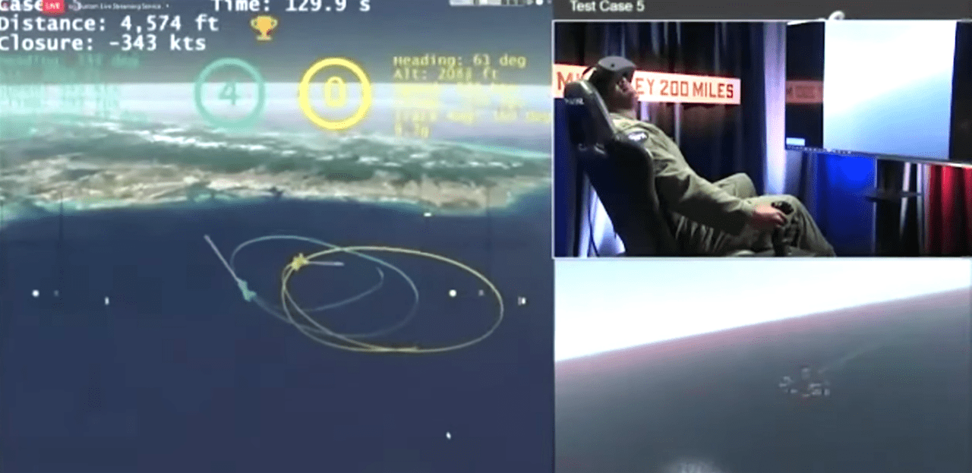
EXERCISE: DARPA Heron Challenge

Slide 81
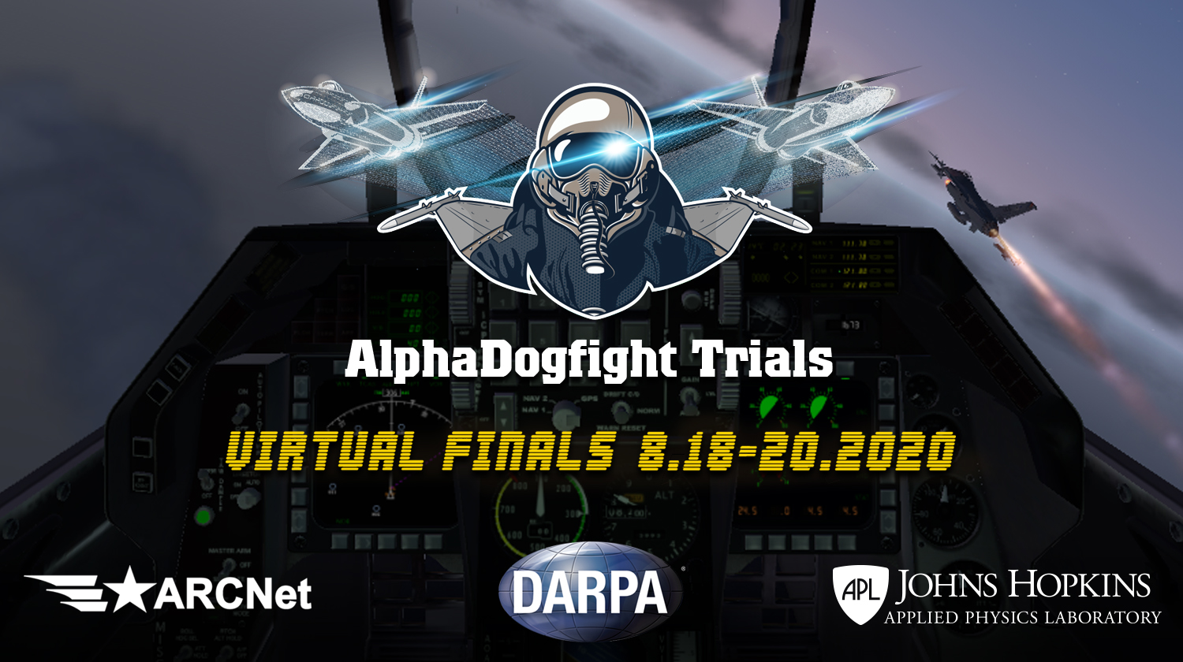
DARPA Heron Challenge (2020)
In August 2020 there was a widely circulated DARPA demonstration.
A pilot lost a virtual F-16 dogfight against a reinforcement learning “AI” made by Heron.
With all 5 rounds lost, does this mean AI superiority to pilots has been achieved?
Watch the video on next slide and discuss whether this proves pilots can now be replaced by “AI.”
Why or why not?
https://www.janes.com/defence-news/news-detail/heron-systems-ai-defeats-human-pilot-in-us-darpa-alphadogfight-trials

Slide 82
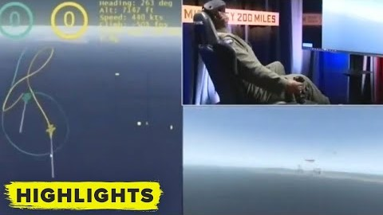
DARPA Heron Challenge (2020)
https://youtu.be/IOJhgC1ksNU

Slide 83
DARPA Heron Challenge (2020)
If the human pilot lost all 5 rounds to Heron, this does show some AI advancement that might be useful for pilot simulation training purposes.
But has AI superiority been achieved? Here are some things to consider:
The simulation was low fidelity, not just in graphics but also physics, pilot functions, and environment.
Ordnance was limited to guns; no missiles or other weapon systems, so objective was simply to get target within “a cone.”
Heron relied heavily on face shots and high-risk maneuvers, which F-16 pilots are trained not to do.
Experienced pilots are often disadvantaged in a simulator, as they lack physical cues they depend on.
The AI had complete situational awareness and access to all simulation variables, while the pilot had to cope with fog of war and was limited to instrument and cockpit view.
Heron was able to generate training data through countless random simulations with a narrow objective, which is often impractical in real world settings.

Slide 84
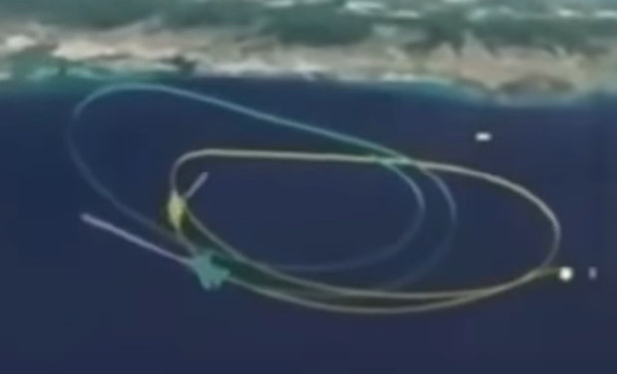
DARPA Heron Challenge (2020)
Has Heron successfully made strides in replacing the pilot?
Probably not, the simulation-to-reality gap is prevalent here.
The simulation over-simplified combat conditions and ignored countless nuances and combat constraints pilots are faced with.
The “AI” has an unfair advantage having omniscient access to all simulation state and data, including pilot’s variables, while the pilot was left in a fog of war.
It may offer some interesting research with reinforcement learning, as well as offer new types of unorthodox computer adversaries for pilots in simulation training.

Slide 85
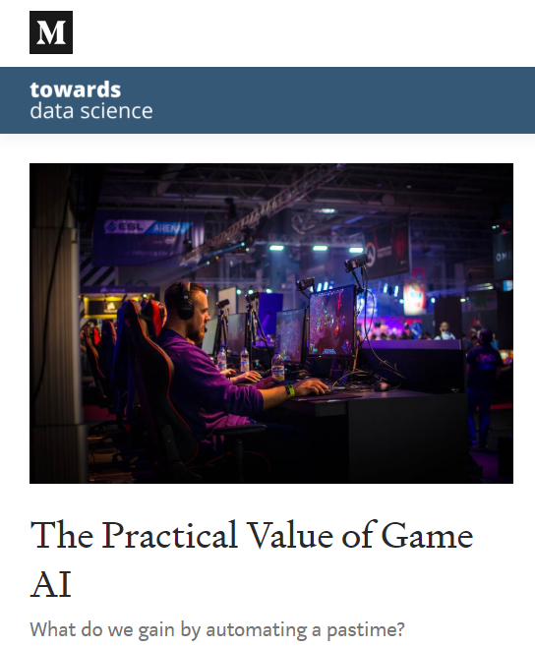
Games and AI Research
Games like Chess, Go, DOTA, and StarCraft are often the subject of AI research and media headlines.
Games are like simulations as they offer a closed world with limited variables, decisions, and outcomes with well-defined objectives.
Traditionally game AI would look 3-4 moves ahead using tree search and choose the branch with the highest likelihood of success.
Contemporary AI research today uses random gameplay (e.g. Monte Carlo tree search) to generate vast amounts of data, and machine learning can train on that data to predict winning moves.
This closed world setting makes games perfect for AI research, but these advantages are rarely found in real-world environments.
Regardless, AI research companies and even DARPA have taken a strong interest in game AI research.
One of the course instructors (Thomas Nield) wrote an article about game AI and why it is hard to generalize.
https://towardsdatascience.com/ai-research-and-the-video-game-fetish-71cb62ffd6b3

Slide 86
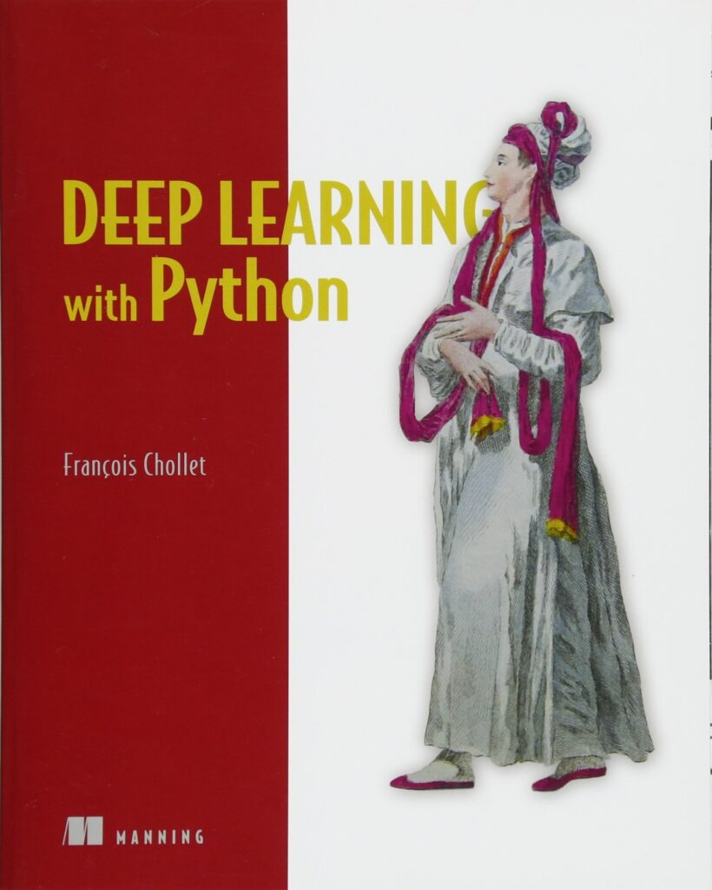
Quote from Francis Chollet
“The thing is, once you pick a measure, you’re going to take whatever shortcut is available to game it. For instance, if you set chess-playing as your measure of intelligence (which we started doing in the 1970s until the 1990s), you’re going to end up with a system that plays chess, and that’s it. There’s no reason to assume it will be good for anything else at all. You end up with tree search and minimax, and that doesn’t teach you anything about human intelligence. Today, pursuing skill at video games like Dota or StarCraft as a proxy for general intelligence falls into the exact same intellectual trap.
There’s no doubt that the effort to beat human champions at specific well-known video games is primarily driven by the press coverage these projects can generate. If the public wasn’t interested in these flashy “milestones” that are so easy to misrepresent as steps toward superhuman general AI, researchers would be doing something else. I think it’s a bit sad because research should about answering open scientific questions, not generating PR. ”
-Francois Chollet, AI Researcher at Google and creator of Keras Tensorflow
[1] https://www.theverge.com/2019/12/19/21029605/artificial-intelligence-ai-progress-measurement-benchmarks-interview-francois-chollet-google

Slide 87

Quote from Francis Chollet (continued)
“If I set out to ‘solve’ Warcraft III at a superhuman level using deep learning, you can be quite sure that I will get there as long as I have access to sufficient engineering talent and computing power (which is on the order of tens of millions of dollars for a task like this). But once I’d have done it, what would I have learned about intelligence or generalization? Well, nothing. At best, I’d have developed engineering knowledge about scaling up deep learning. So I don’t really see it as scientific research because it doesn’t teach us anything we didn’t already know. It doesn’t answer any open question. If the question was, ‘Can we play X at a superhuman level?,’ the answer is definitely, ‘Yes, as long as you can generate a sufficiently dense sample of training situations and feed them into a sufficiently expressive deep learning model.’ We’ve known this for some time. ”
-Francois Chollet, AI Researcher at Google and creator of Keras Tensorflow
Simulation and video game-based AI dominate headlines with breakthroughs in reinforcement learning, but practical value remains elusive.
https://www.vox.com/future-perfect/2019/9/20/20872672/ai-learn-play-hide-and-seek
[1] https://www.theverge.com/2019/12/19/21029605/artificial-intelligence-ai-progress-measurement-benchmarks-interview-francois-chollet-google

Slide 88
CASE STUDY: Uber Tempe Incident

Slide 89
Uber Tempe Accident
Here are some reports and documents surrounding the Uber Tempe crash in 2018.
https://www.ntsb.gov/investigations/AccidentReports/Reports/HAR1903.pdf
https://1drv.ms/b/s!AoxKpPBUQ5LnltoUnQExu3QDb-ihkg?e=cNV79a
Let’s disregard human factors and focus on how this deep learning system (and larger system overall) failed.
Let’s discuss technical factors that triggered hazards leading up to the accident.

Slide 90

Setting the Stage
Sunday, March 18, 2018
9:58 PM
Tempe, Arizona
Uber deployed a modified 2017 Volvo XC90 into a geofenced route for testing.
The vehicle was engaged in autonomous operation but had a human operator monitoring.
A pedestrian jaywalking a bicycle started crossing Mill Avenue and into a collision path with the vehicle.
The vehicle was engaged in autonomous operation and failed to slow, fatally striking the pedestrian at 39 MPH.

Slide 91

Setting the Stage
The vehicle was equipped to be “self-driving” and had the following sensors:
Forward/side facing cameras
Radar and ultrasonic
LIDAR
Telemetry, positioning, monitoring, and telecommunications
The system relied on detailed mapping data and localization to identify speed limits and appropriate lanes.
LIDAR, followed by computer vision, was heavily instrumental for object detection and classification, as well as create a map of the designated route up to 238 feet.
Ultrasonic sensors with 16 foot range detected immediate obstacles for collision avoidance.
The operator was tasked with intervening when automation failed, and she was distracted by her phone right before the accident.
The automation was fully engaged for 19 minutes prior to the collision.

Slide 92


Opening the Black Box
6 seconds prior to impact, the vehicle LIDAR and radar pinged the pedestrian at 43 MPH.
However as it closed in on the pedestrian, misclassifications started to alternate:
“Unknown object”
“Vehicle”
“Bicycle”
Each misclassification caused it to predict a different trajectory and travel path based on that prescribed heuristic.
1.3 seconds prior to impact, the system identified the need for emergency braking, but it was disabled to reduce “erratic vehicle behavior” and rely on operator to intervene in emergencies.

Slide 93

Opening the Black Box
An important heuristic to note is “the ADS used a prioritization schema that promoted tracking by certain sensory systems over others, and that was also dependent on the recency of an observation” (Page 12).
“Once the ADS perception process classified a detected object, the ADS generated multiple possible trajectories—path predictions—based on the typical goal of the detected object and its tracking history” (Page 12).
“Certain object classifications (“other”) were not assigned goals. Their currently detected location was viewed as static, and unless the location was directly on the path of the test vehicle, the object was not considered a possible obstacle. Pedestrians outside the vicinity of a crosswalk were also not assigned an explicit goal” (Page 13).
The system also used heuristics based on assumed contexts:
“The system never classified her as a pedestrian—or correctly predicted her path—because she was crossing N. Mill Avenue at a location without a crosswalk, and the system design did not include consideration for jaywalking pedestrians” (Page 16).
Yurtsever et al. demonstrate object tracking at a busy intersection. Pedestrians and cyclists leave a trail of their previous path and a model points an arrow to their predicted trajectory.
SOURCE: Yurtsever, E., Lambert, J., Carballo, A., & Takeda, K. (2020). A survey of autonomous driving: Common practices and emerging technologies. IEEE Access, 8, 58443-58469.

Slide 94


Opening the Black Box
“No alert was given to the operator when action suppression was initiated. ATG stated that it implemented action suppression because of concerns about false alarms—the ADS identifying a hazardous situation when none existed—that would cause the vehicle to engage in unnecessary extreme maneuvers. The primary countermeasure in an emergency situation was the vehicle operator, who was expected to recognize the hazard, to take control of the vehicle, and to intervene appropriately” (Page 13).
In other words, false positives of emergency situations would cause more problems so it was just disabled, and intervention responsibility was handed over to the driver.

Slide 95
Opening the Black Box
“If a vehicle operator did not take control of the vehicle in an emergency and the situation remained hazardous after action suppression, the ADS response depended on whether a collision could be avoided with a maximum braking of 7 m/s and a maximum deceleration rate of 5 m/s. If a collision could be avoided with the maximum allowed braking and jerk limit, the system executed its plan and engaged braking to the maximum allowed.
“If a collision could not be avoided with the application of maximum allowed braking, the system was designed to send an auditory alert to the vehicle operator while simultaneously initiating gradual vehicle slowdown. In such circumstances, the ADS was not designed to apply maximum braking only to lessen the severity of a collision. Since the crash, ATG has changed the way the ADS responds in an emergency situation. The system will now activate maximum allowed braking for crash mitigation as well.”
QUESTION: Is this an end-to-end machine learning model?

Slide 96

Timeline
Note this interesting progression in how the pedestrian is classified

Slide 97


Timeline
Note this interesting progression in how the pedestrian is classified

Slide 98

Timeline
Note this interesting progression in how the pedestrian is classified.

Slide 99
DISCUSSION: What went wrong on a machine learning and software level? What might have remedied the issue?

Slide 100
What Caused the Hazard? (No Human Factors)
Orange – Initiating factor
Blue – Propagated factor
Red – Actuated hazard
Pedestrian enters road by jaywalking instead of crosswalk
Classification logic is fuzzy, stochastic, and likelihood-based due to infinite number of possible inputs
Emergency detection only provides 1.2 seconds of warning
ADS “sees” pedestrian but alternates classification between “vehicle,” “unknown object,” and “bicycle”
Classification is done on contextual assumptions (e.g. “pedestrians only exist on crosswalks”)
Lax safety features and logic
1 second of response time is given to operator to respond
Between classifications chronological context is lost and path predictions vary wildly
Sloppy heuristics provide little guardrails against obvious discrepancies in object classification
Vehicle fails to stop for pedestrian in timely manner

Slide 101
Lessons Learned (Technical Factors)
1) Fuzzy logic with a stochastic/probabilistic nature requires immense amounts of guardrails and heuristics; Computer vision, LIDAR, and other pixelated techniques can have infinite combinations of inputs, which creates uncertainty requiring safeguards that restore safe and predictable behavior.
2) Challenge assumptions about operating domains; it is easy to assume a perfect world where pedestrians use crosswalks and operating domains stay consistent, but reality is chaotically disruptive, and upsets must be accounted for.
3) Hunt down and capture logical inconsistencies; the moment misclassification/path prediction of the pedestrian started flickering, a cautious heuristic should have been used to slow down the vehicle and get operator’s attention.
4) Have a safety management system (SMS) program! Uber did not have a formal safety management system in place, and the system design clearly shows this.
What other lessons do you think exist?

Slide 102
Section VII Resources

Slide 103




Great Books to Learn More About Machine Learning

Slide 104
3Blue1Brown
But what is a convolution?
https://www.youtube.com/watch?v=KuXjwB4LzSA
Neural networks
https://www.youtube.com/watch?v=aircAruvnKk&list=PLZHQObOWTQDNU6R1_67000Dx_ZCJB-3pi

